Slide 1


Beaufort County Schools
Personnel Training
By: The Schools Nurses
Notes:
Welcome to the beginning of the new school year. This presentation has been developed by your school nurses to ensure all Beaufort County employees received the same information.

Slide 2


Cindy Edwards, BSN, RN, NCSN – Lead Nurse
-Washington High, BCHS Early College
Bonnie Keech, BSHCM, RN, NCSN
-Northeast Elementary, Northside High
Erica Lassiter, BSN, RN, NCSN
-Chocowinity Primary
Cindy Tipton, BSN, RN, NCSN
-S.W. Snowden Elementary, Southside High, Ed Tech
Catherine Pfeiffer, BSN, RN, NCSN
-Eastern Elementary
Tanya Ange, BSN, RN, NCSN
-P.S. Jones Middle
Jennifer Allen, RN
-Bath Elementary
Karen Williams, RN
-Chocowinity Middle
Betsy Dobson, RN
-John Small, John Cotten Tayloe
With 9 nurses covering 14 schools it is imperative that we support each other.
We work together as a team and may need to be off campus at times assisting our nurses during the work week.
Notes:
There are 9 school nurses covering the 14 schools in Beaufort County.
We work together as a team and travel through out the county to assist each other as needed.

Slide 3
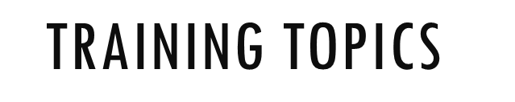

Bloodborne Pathogens
First Aid
Handwashing
Asthma
AEDs & Stock Epi
Anaphylaxis
Seizures
Diabetes
EAPs
Concussions
Medication
Injury Reports
Head Lice
Student Referrals
Illness at School
Notes:
We will cover the following topics in this presentation.
For additional information or questions please contact your school nurse.

Slide 4


Notes:
OSHA requires annual training on bloodborne pathogens, this will fulfil your annual training requirements.

Slide 5
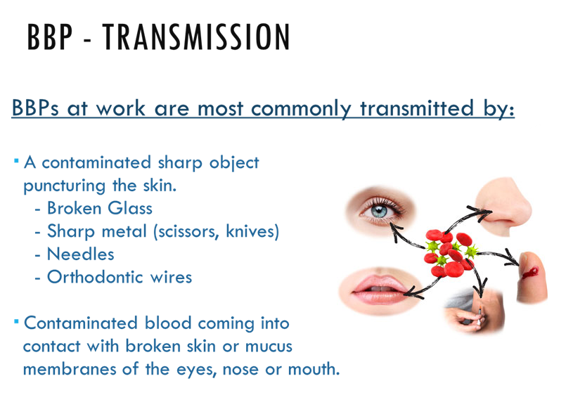
Notes:
Bloodborne pathogens are most commonly transmitted by contaminated sharp objects puncturing the skin, and coming into contact with contaminated blood through broken skin, eyes, nose, or mouth.

Slide 6
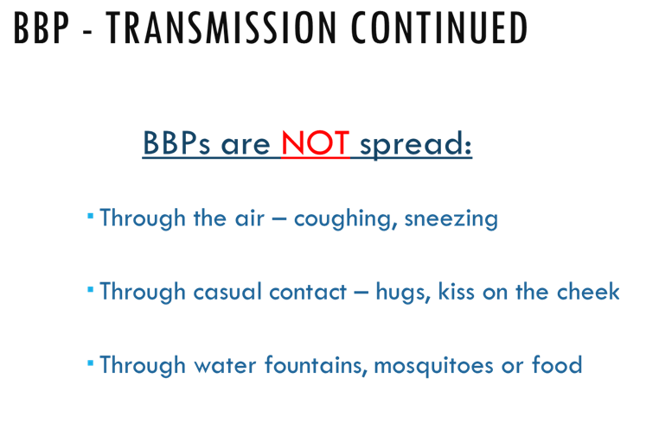
Notes:
They are not spread through the air, casual contact, mosquitoes, or water fountains.

Slide 7
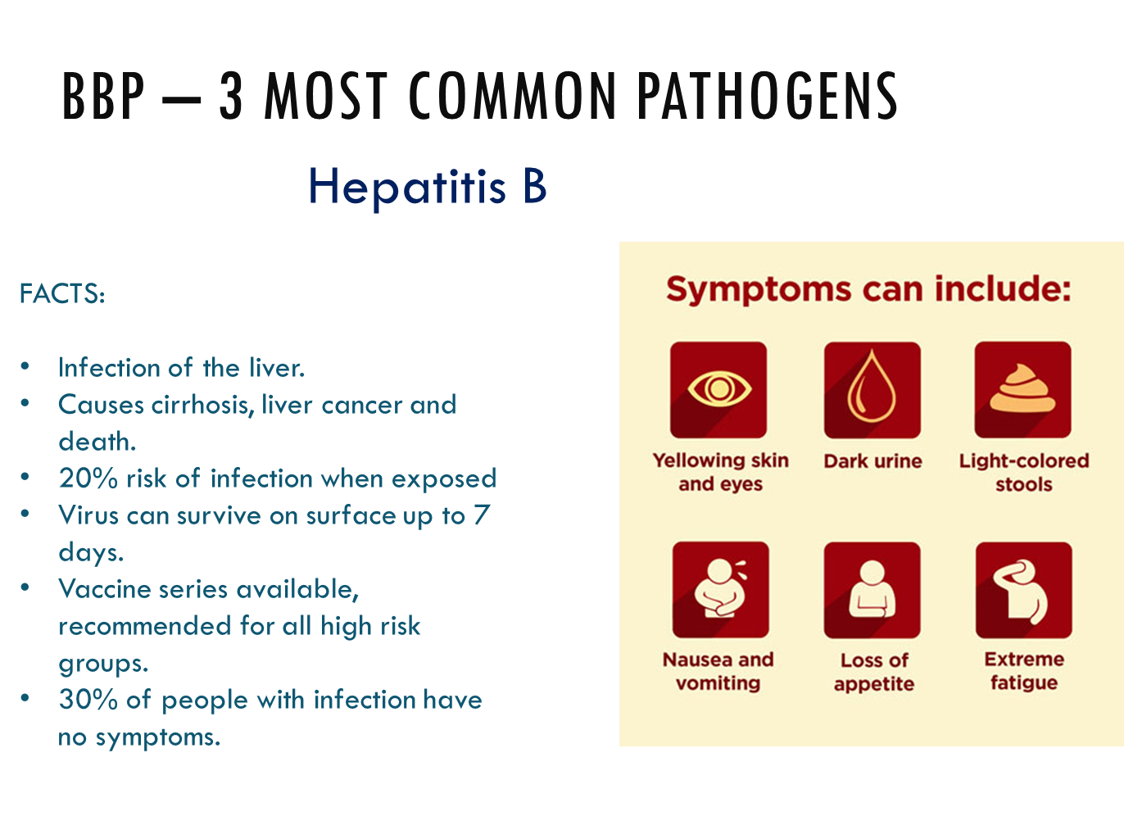
Notes:
The three most common bloodborne pathogens are Hepatitis B, Hepatitis C and HIV.
Hepatitis B is an infection of the liver that can be prevented by vaccination. The most noticeable symptoms of hepatitis include yellowing of the skin and dark urine. However, thirty percent of infected individuals have no symptoms.

Slide 8
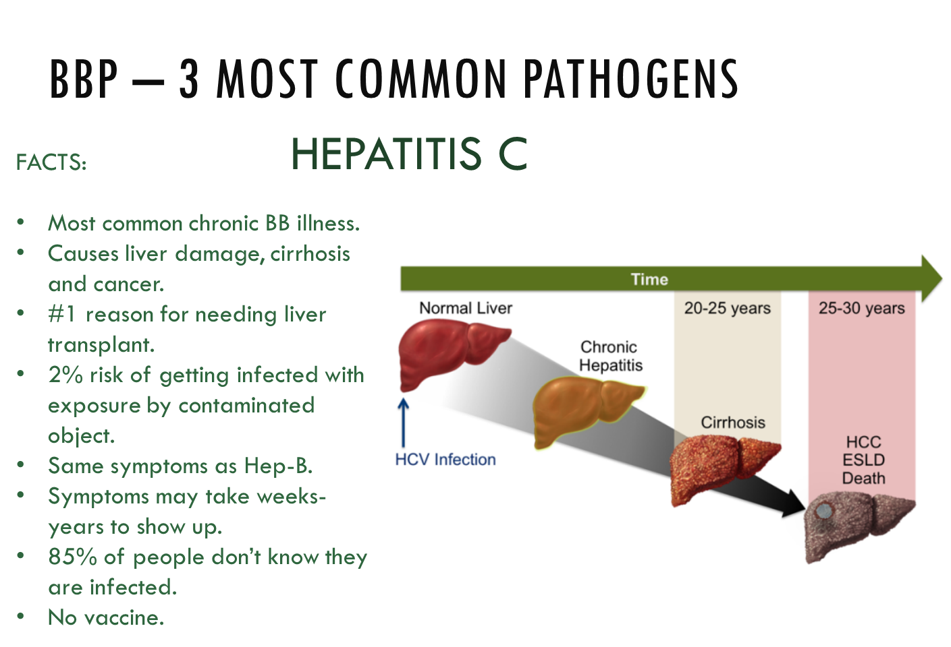
Notes:
Hepatitis C is the most common chronic bloodborne illness. Hep-C has the same symptoms as Hep-B, however there is no vaccination to protect against it. Eighty-five percent of people with Hep-C do not know they are infected.

Slide 9
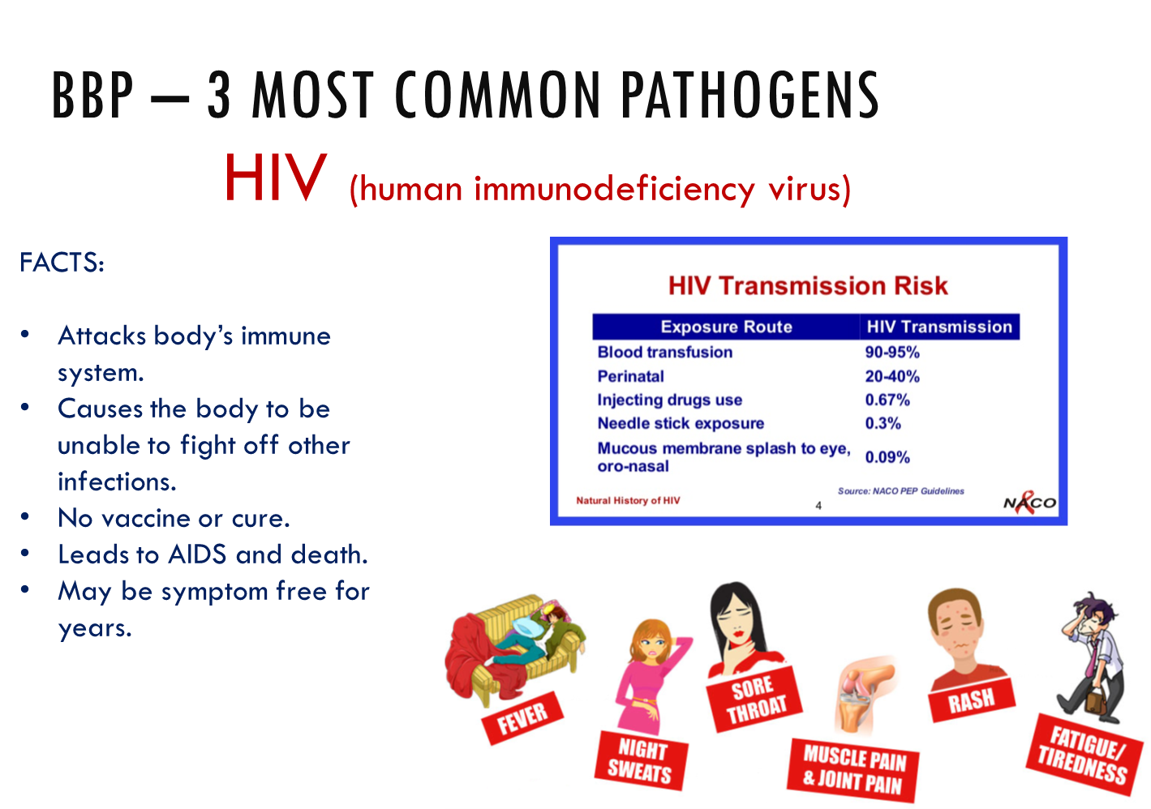
Notes:
HIV is a virus that attacks the immune system causing the body to be unable to fight off infection. After contracting HIV an individual may be symptoms free for many years. There is no vaccine for HIV.

Slide 10
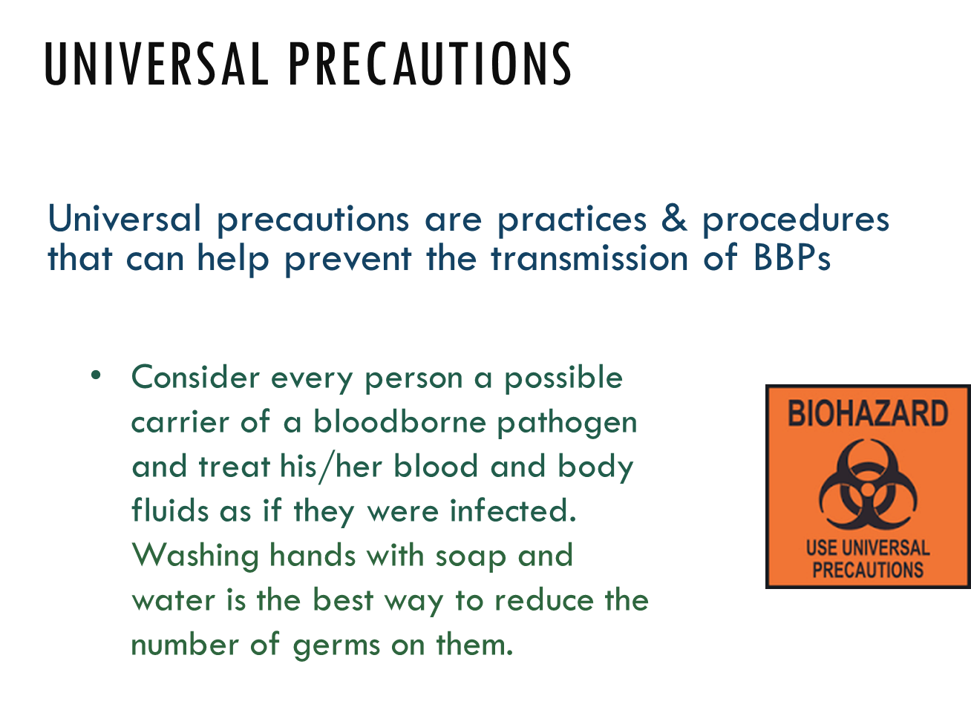
Notes:
Universal precautions are in place to help prevent the spread of bloodborne pathogens.
Consider every person infected and every occurrence a potential exposure.
Always remember to wear gloves and wash your hands with soap and water.

Slide 11
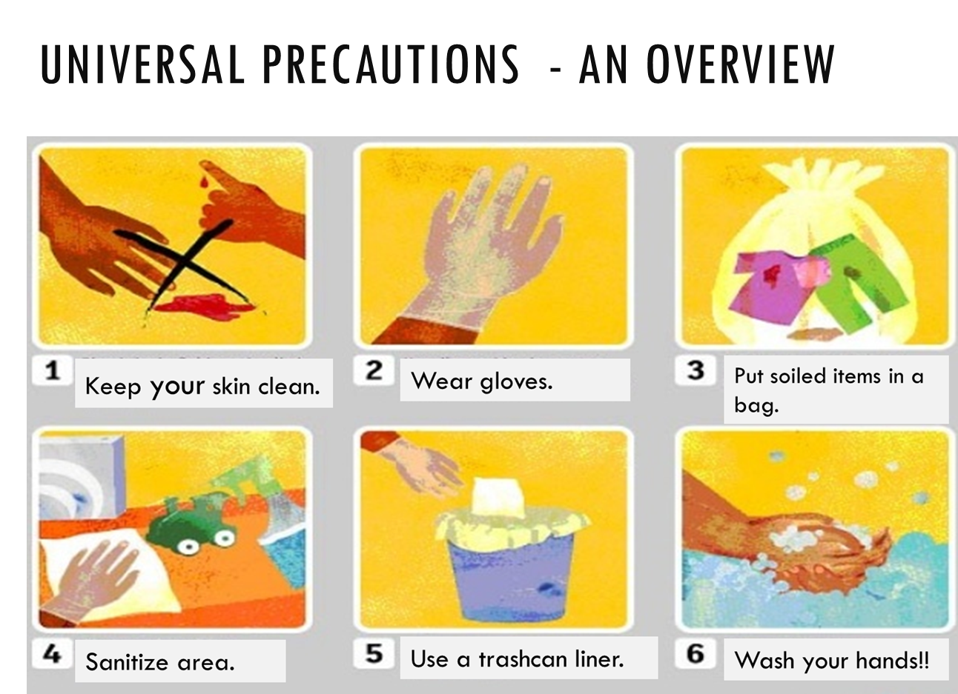
Notes:
There are six key concepts to universal precautions. Keep your skin clean, wear gloves, put soiled items in a bag, sanitize contaminated areas, use a trash bag, and wash your hands, wash your hands, wash your hands!!!

Slide 12
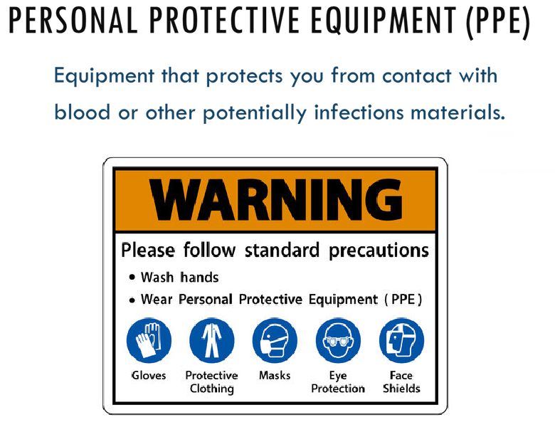
Notes:
Personal protective equipment protects you by keeping your skin clean.
PPE includes gloves, aprons, protective eye wear, and masks.

Slide 13
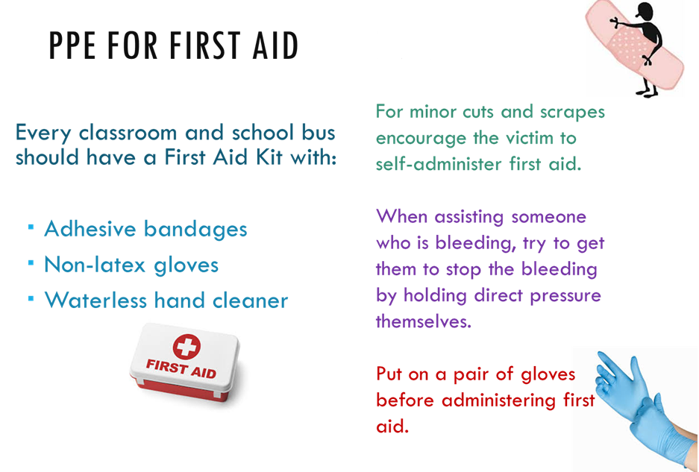
Notes:
For minor cuts and injuries encourage the student to wash their hands with soap and water and apply a Band-Aid.
When assisting with first aid wear gloves and then provide treatment.

Slide 14
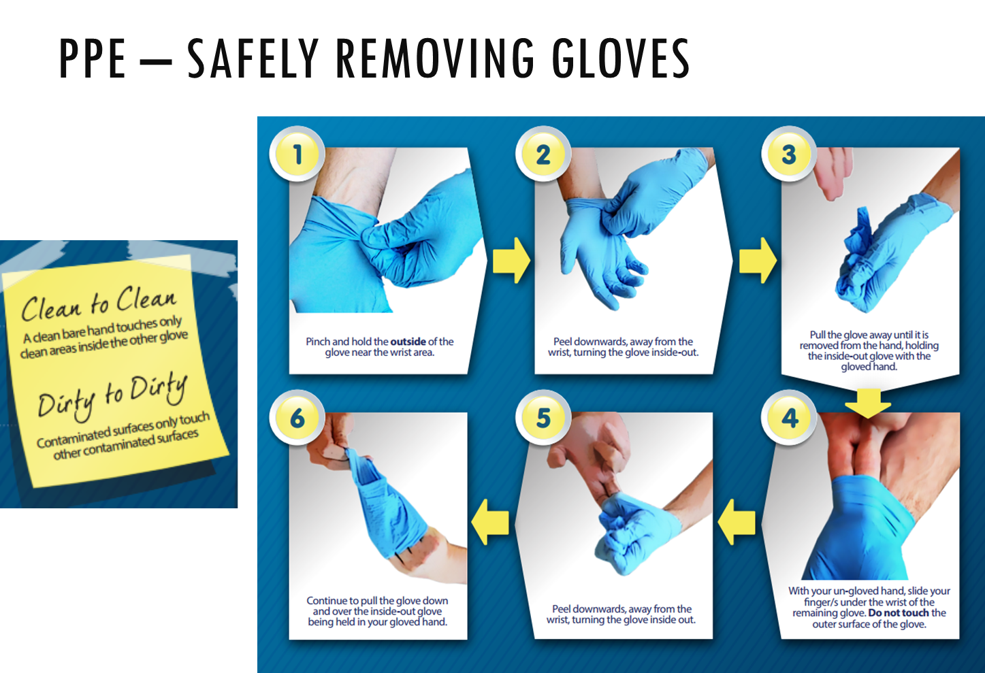
Notes:
When removing gloves remember clean to clean and dirty to dirty.
This means do not touch the outside of the gloves with your bare hands.

Slide 15
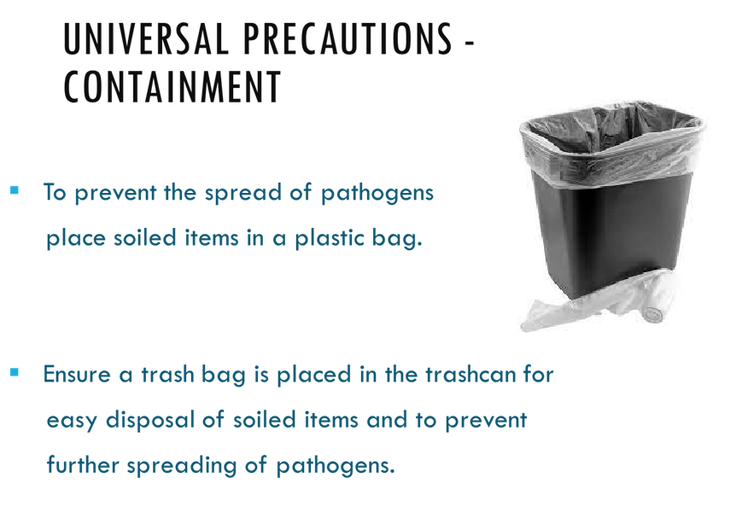
Notes:
To prevent the spread of pathogens contain them by keeping all soiled items in a plastic bag.

Slide 16
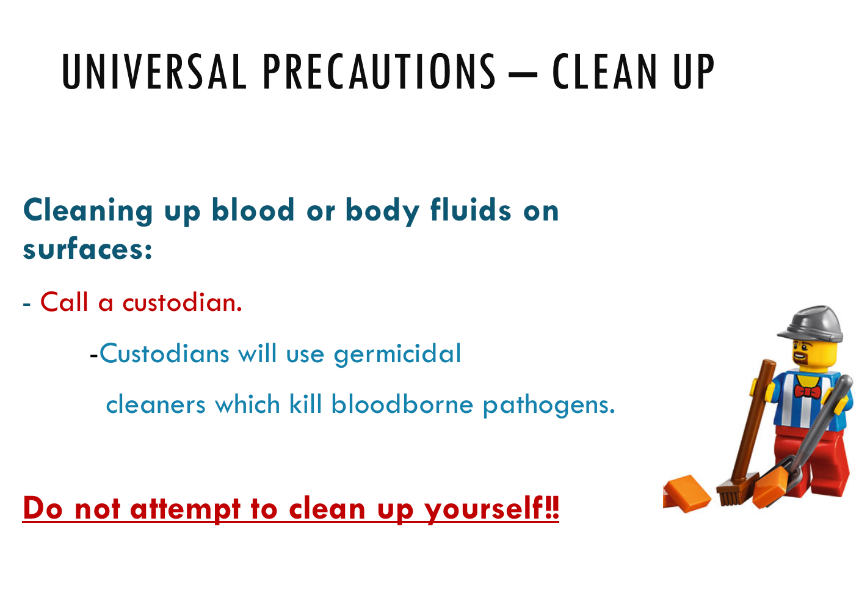
Notes:
When contaminated surfaces are present call for a custodian.
They trained to prevent the spread of blood borne pathogens and have the needed cleaning products for disinfection.
Do not attempt to clean yourself!

Slide 17
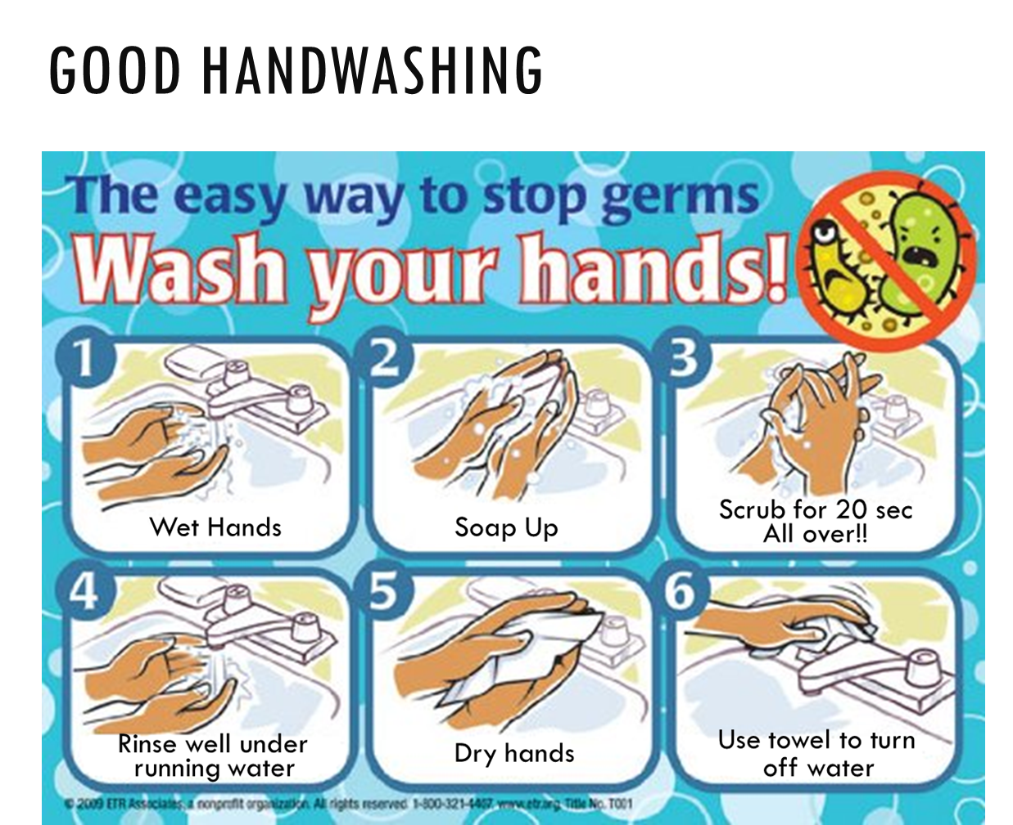
Notes:
Proper handwashing is essential to preventing the spread of germs.
Scrubbing hands for 20 seconds and using a paper towel to turn off water are crucial steps often shortened or skipped.
Since COVID, we all have realized proper handwashing is essential to preventing the spread of germs.

Slide 18
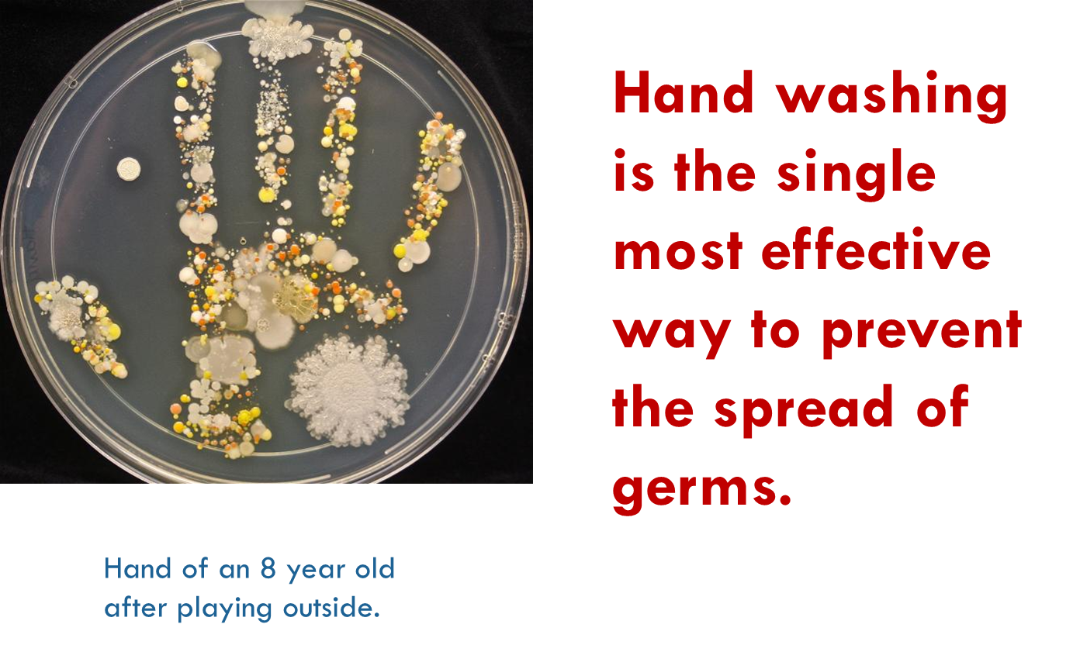
Notes:
Hand washing is the single most effective way to prevent the spread of germs.

Slide 19
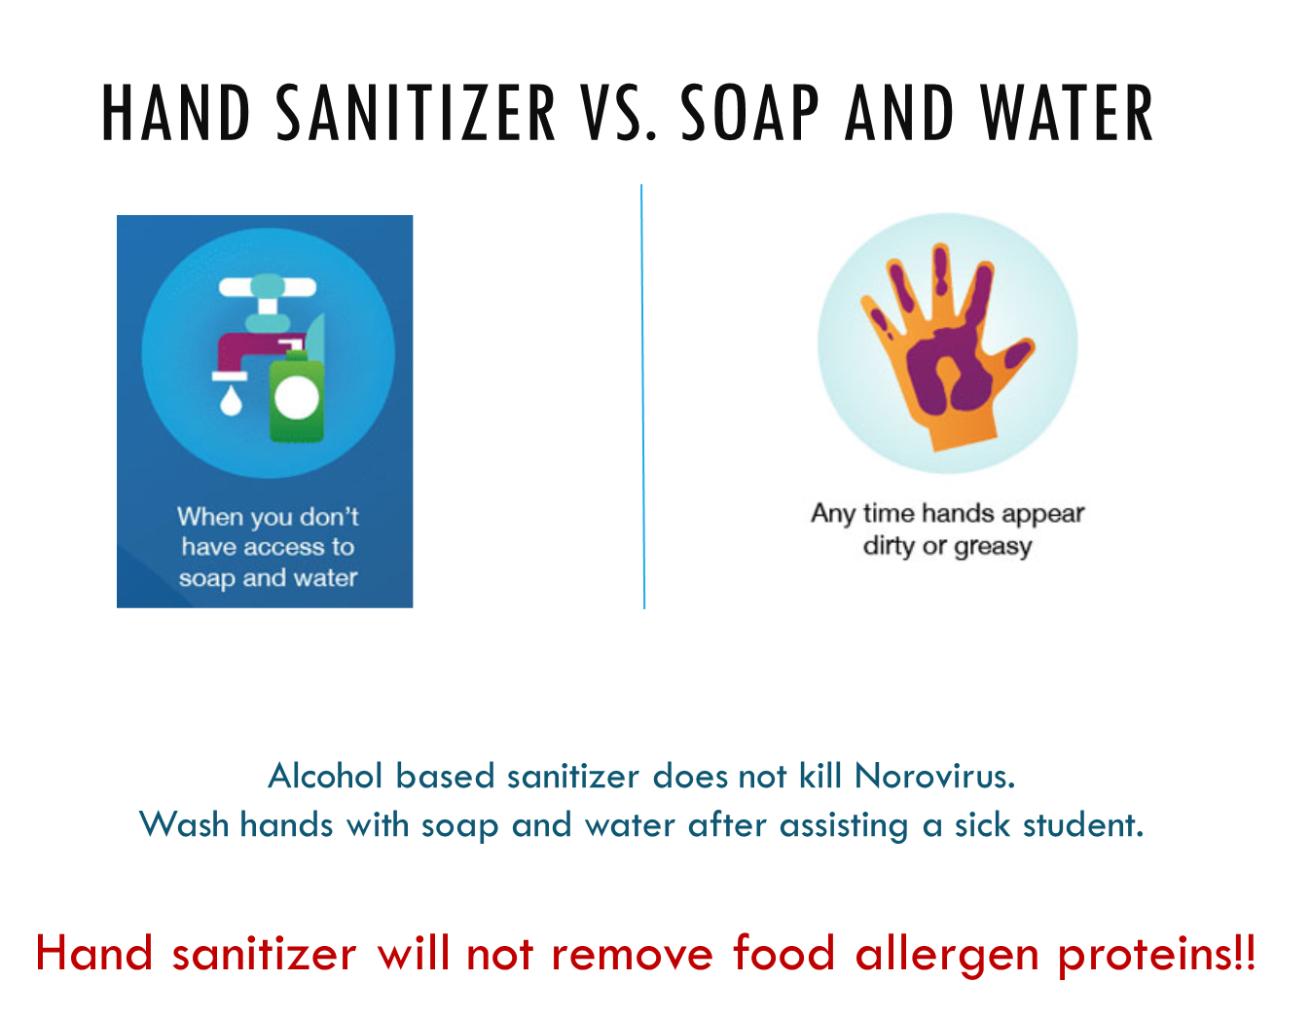
Notes:
Soap and water is most effective when available. If not available and hands are not visibly dirty sanitizer is an acceptable alternative.

Slide 20
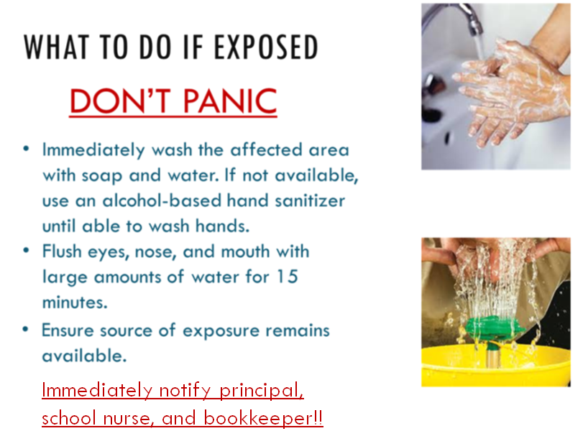
Notes:
Please don’t panic!
Immediately wash affected areas following the handwashing guidelines.
Flush eyes, nose, and mouth with large amounts of water for 15 minutes.
Reports incident to school nurse and principal immediately.
Ensure source of exposure remains available.

Slide 21
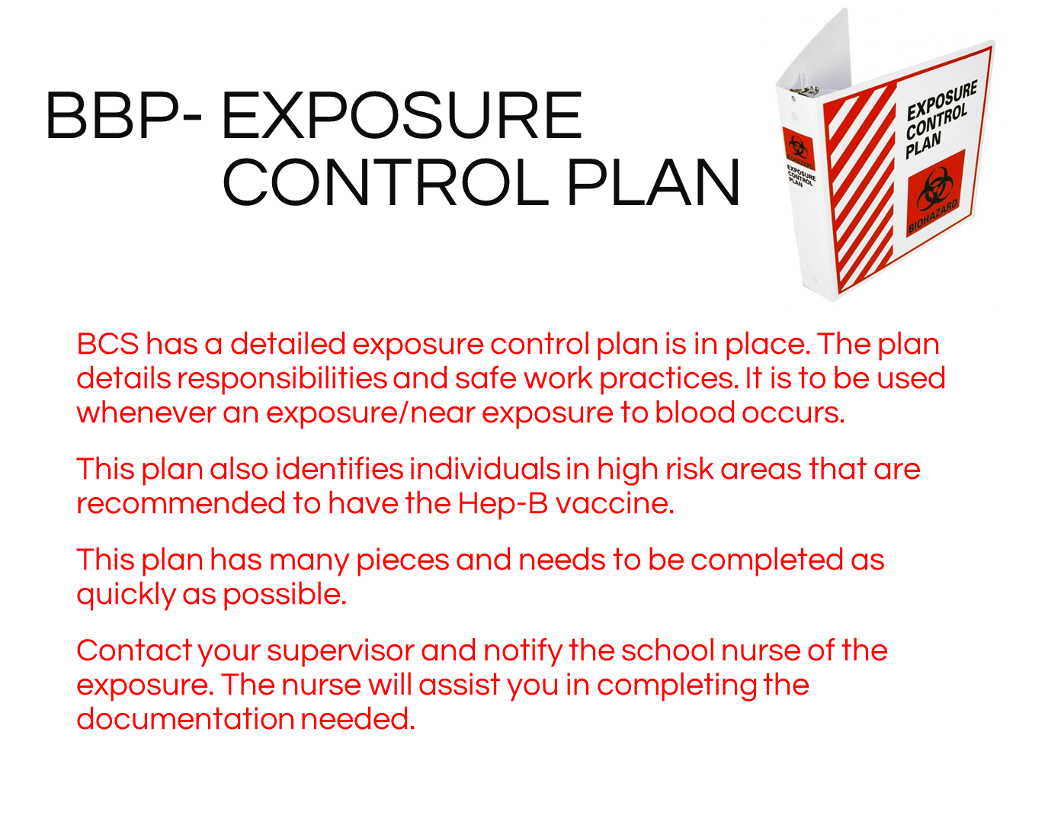
Notes:
Beaufort County Schools has a detailed exposure control plan, a copy of which is located in your front office. It details responsibilities and safe work practices. It should be used whenever an exposure or near exposure to blood occurs. Remember to contact your school nurse and principal IMMEDIATELY following an exposure.

Slide 22
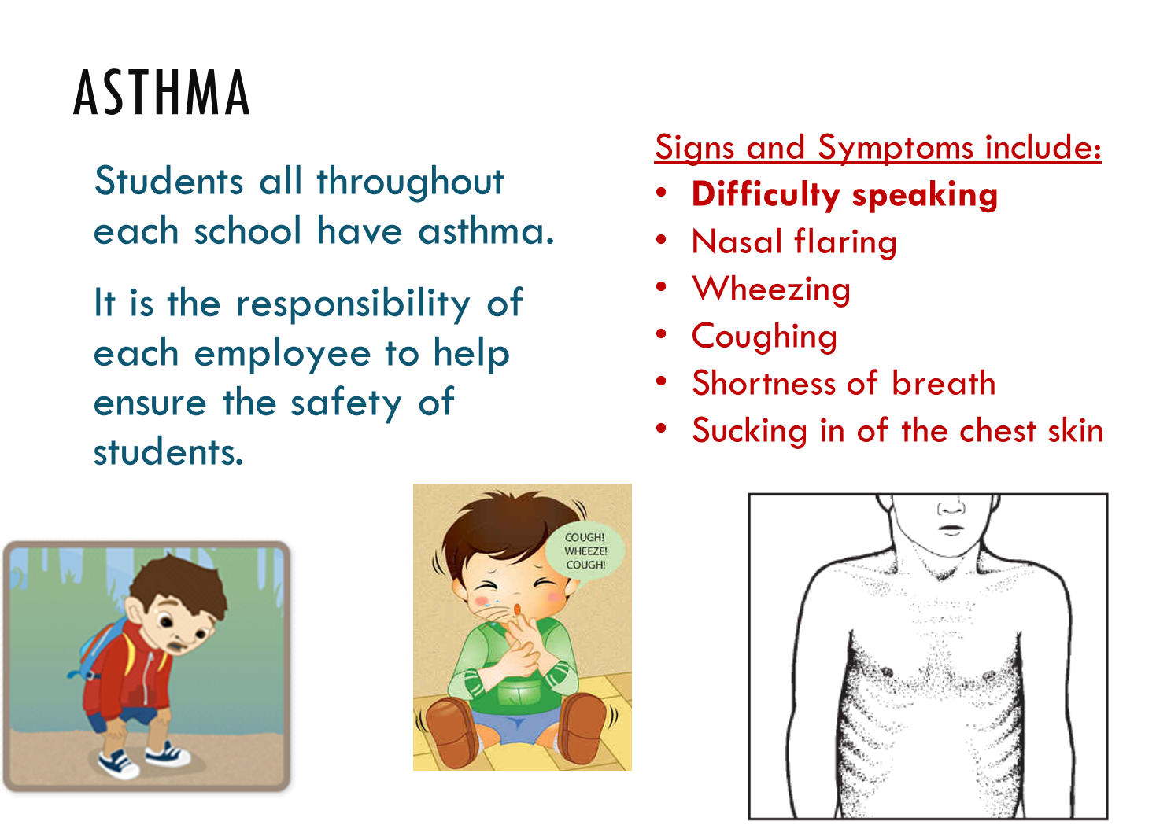
Notes:
Countless students and staff members throughout the school have asthma.
Some are identified and some are not.
It is the responsibility of us all to help in providing a safe harbor for our children.
Significant signs and symptoms are listed, some or all may be present.

Slide 23
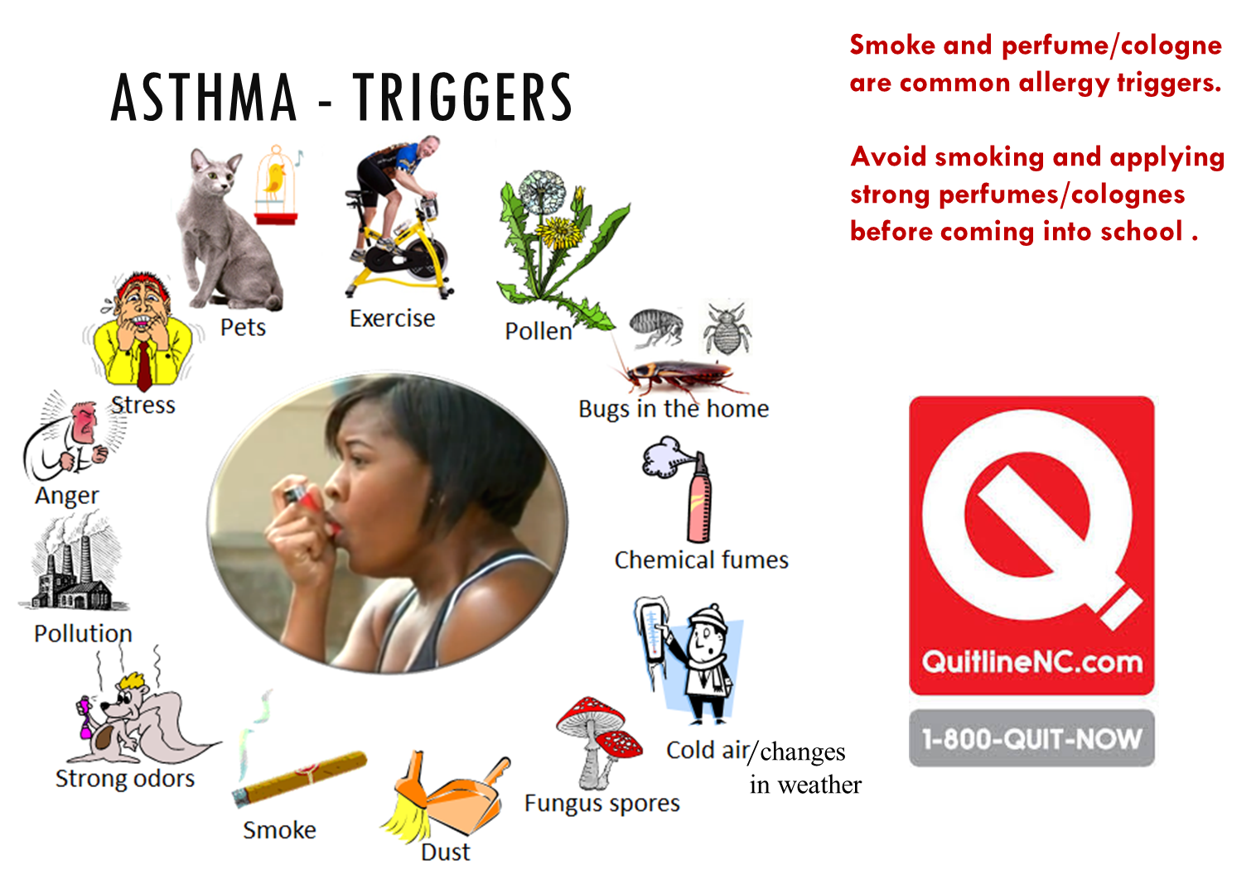
Notes:
Please be aware that multiple asthma triggers exist.
Smoke and strong smells are two of the most common.

Slide 24
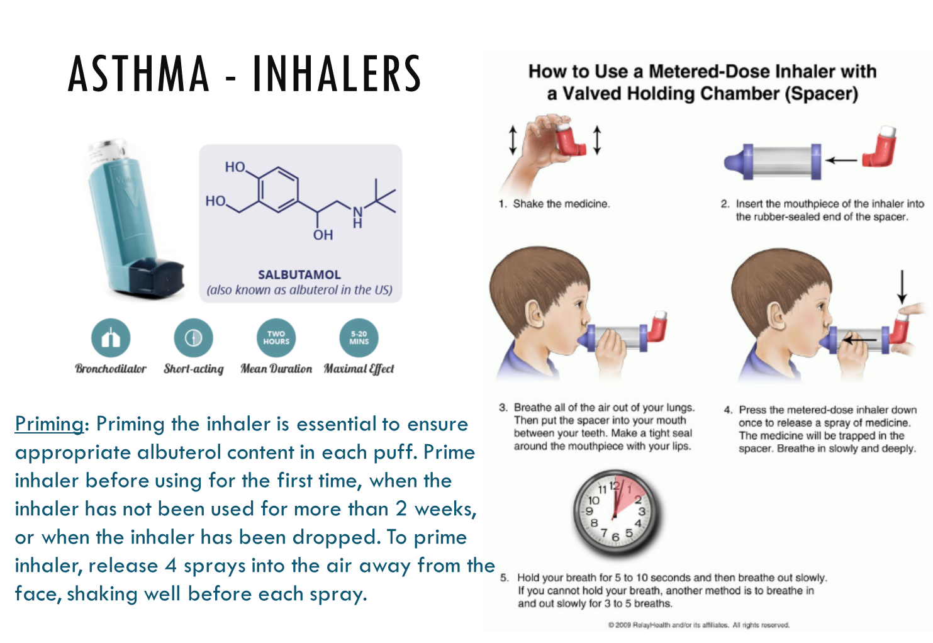
http://www.beaufort.k12.nc.us/Page/8074
Notes:
Elementary students will need assistance using their inhaler.
It is necessary to use a spacer when available to ensure delivery of medication.
Asthma pumps that have not been used in the last 2 weeks will need to be primed by releasing 4 sprays into the air away from the student before use.
(need to fix video clip or imbed)

Slide 25
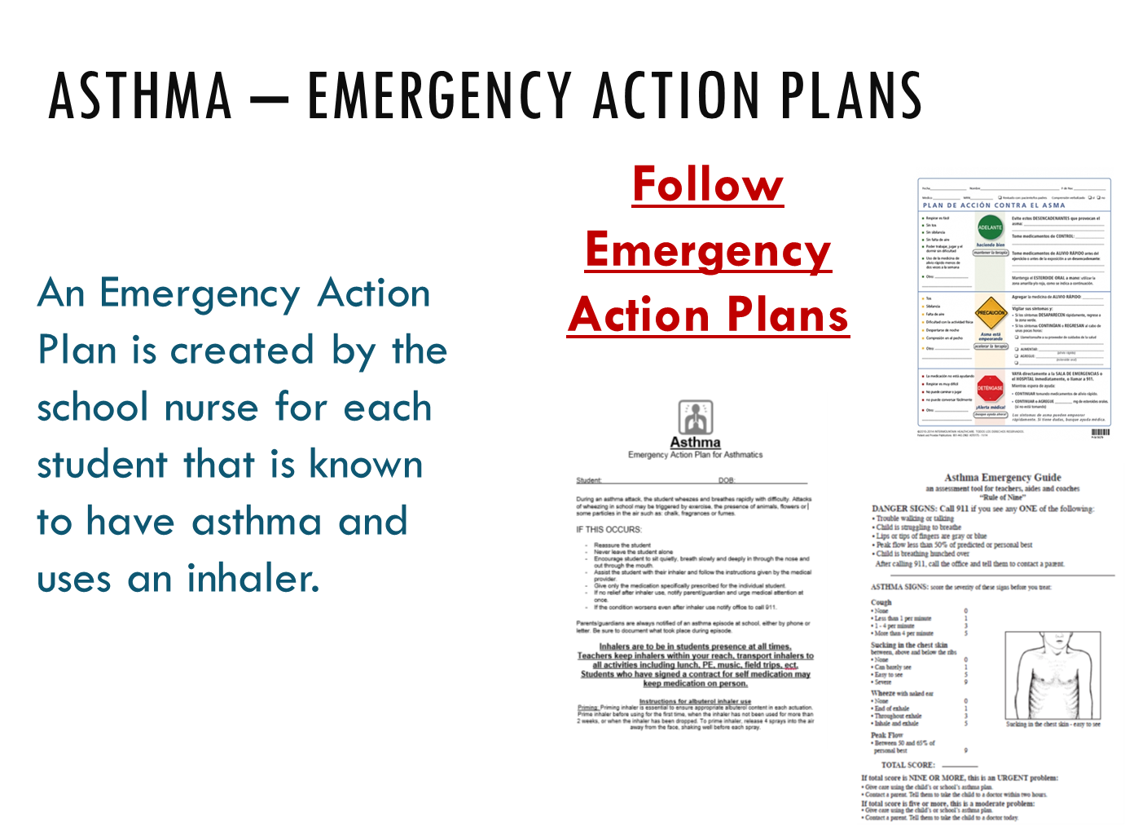
Notes:
For every student that has asthma and an inhaler at school an Emergency Action Plan will be available as a resource.

Slide 26

Notes:
Thanks to Vidant Beaufort Hospital, all schools have AEDs available for emergencies.
It is state law that EpiPens are available for allergic reactions.
First Responders are available at each school for emergencies. Please know who your first responders are and be aware where your Epi-Pens and AEDs are located.

Slide 27
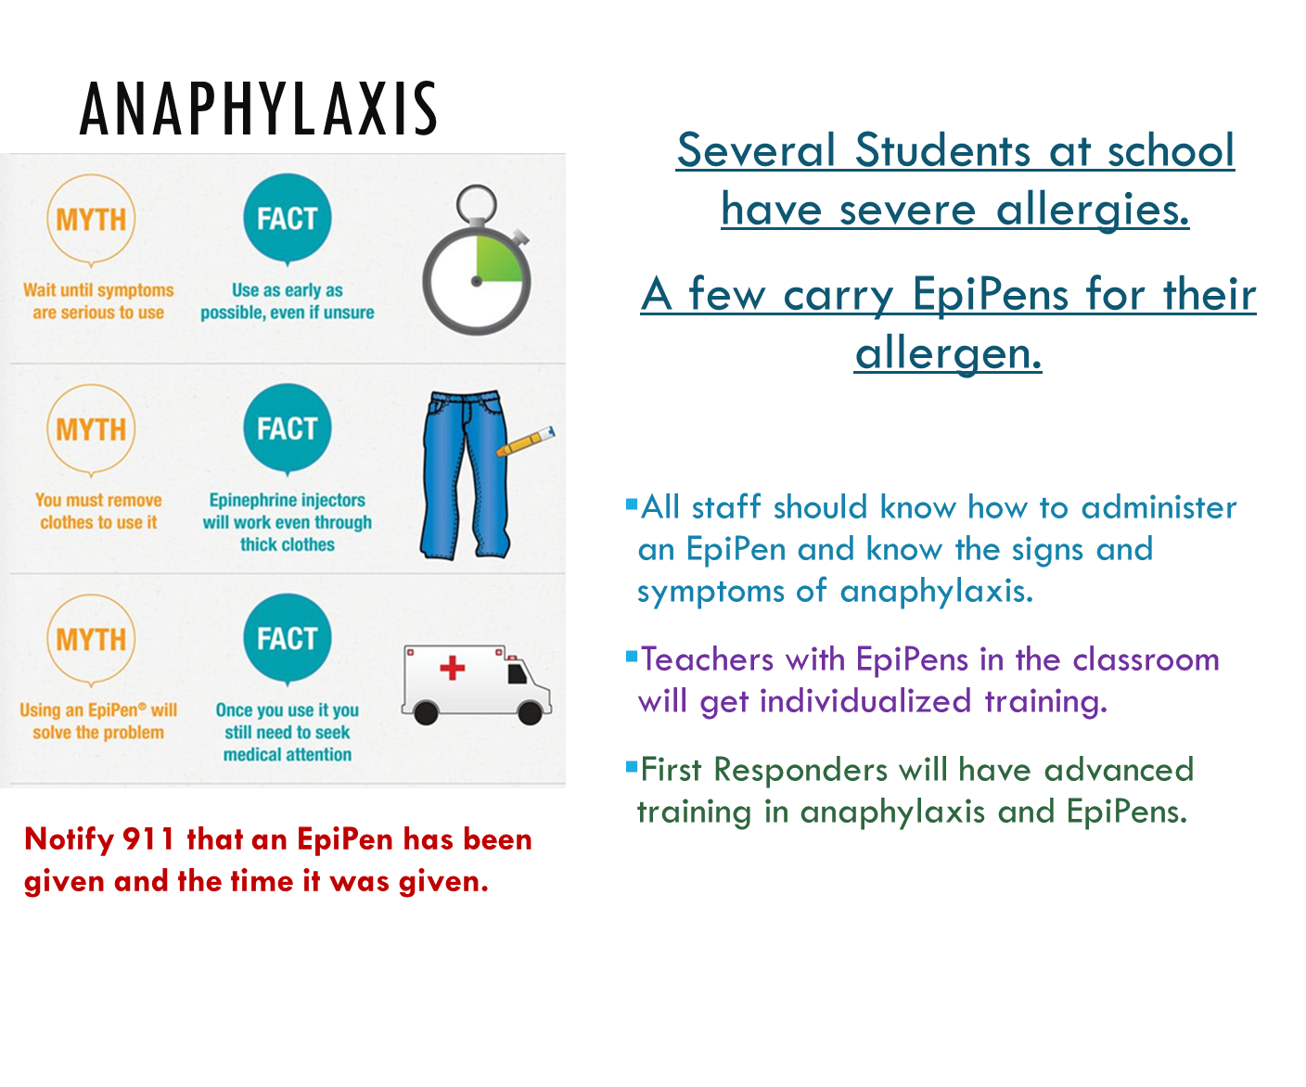
Notes:
Please be aware that there are students at each school who have severe allergies and carry epipens.
For the safety of staff and students, all staff should be familiar with the signs and symptoms of anaphylaxis, a life threatening allergic reaction, and how to administer an epipen.
First responders and teachers with students that require epipens will receive additional training.
Whenever an EpiPen is given 911 must be called. Notify them that an Epipen was administered and the time it was given.

Slide 28
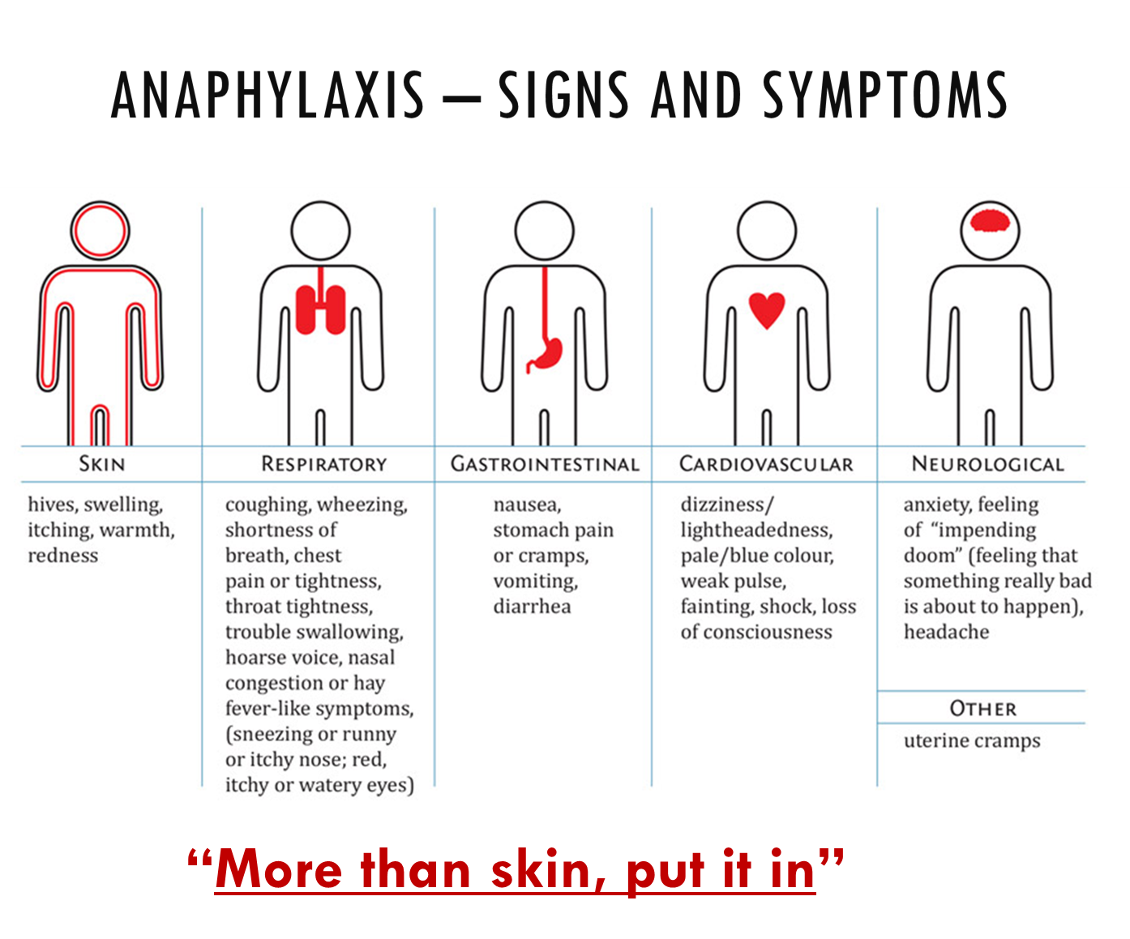
Notes:
Allergic reactions can involve one or more body systems. Some of the most common are listed above. Please be familiar with the handout provided and have it available for reference.
If you don’t have a copy of this handout for your classroom please let your school nurse know.

Slide 29
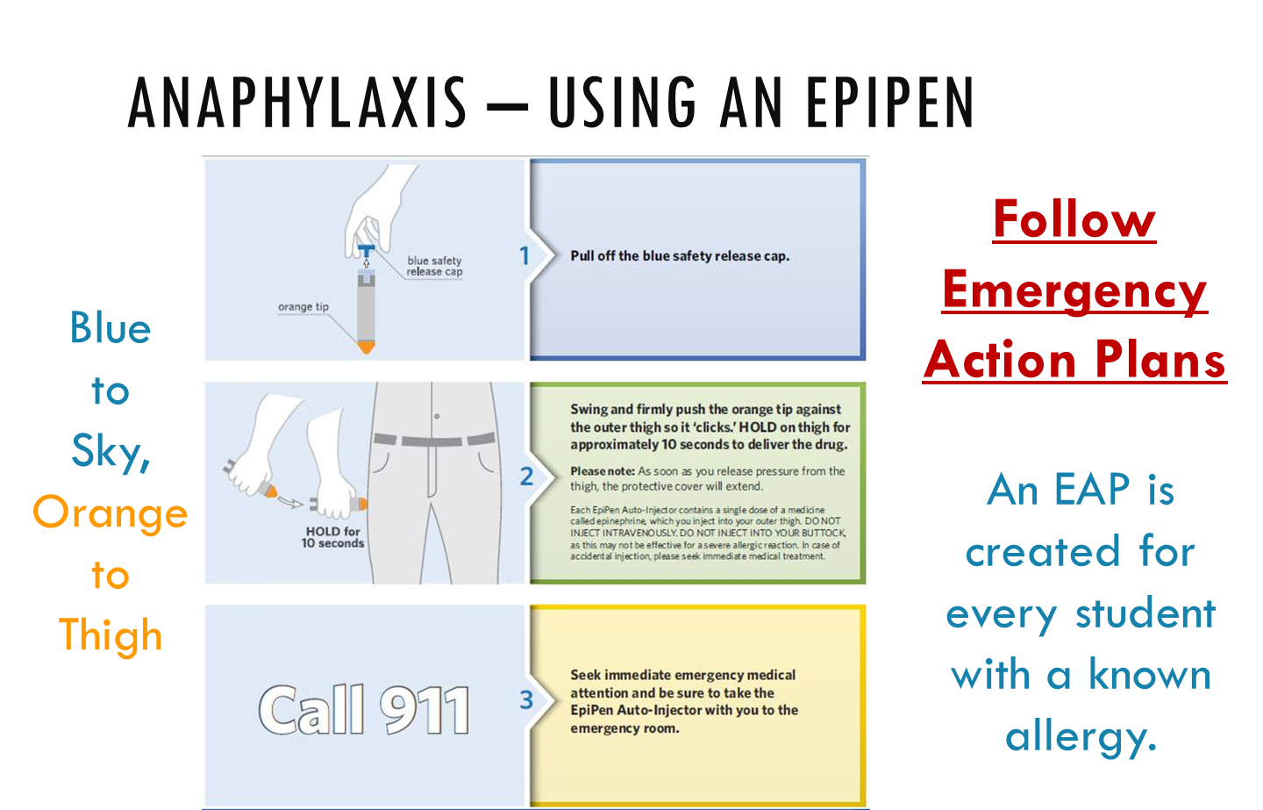
Notes:
Emergency Action Plans are created for students with known severe allergies who carry EpiPens.
However, many anaphylactic reactions can be undiagnosed allergens.
Never hesitate to use an EpiPen if warranted. It will not harm the individual.

Slide 30


Slide 31
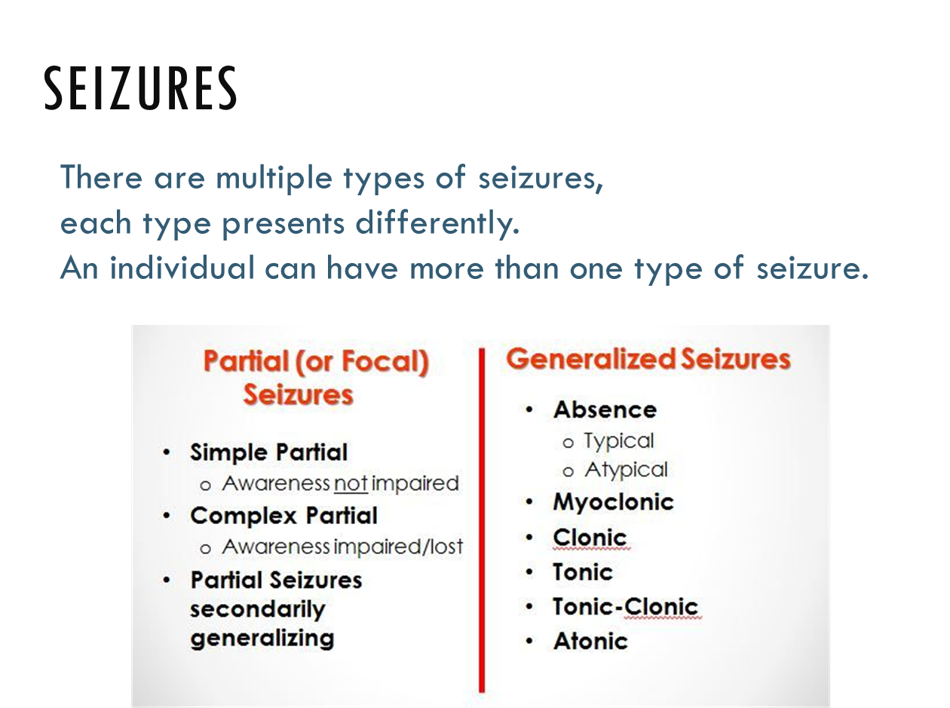


Slide 32
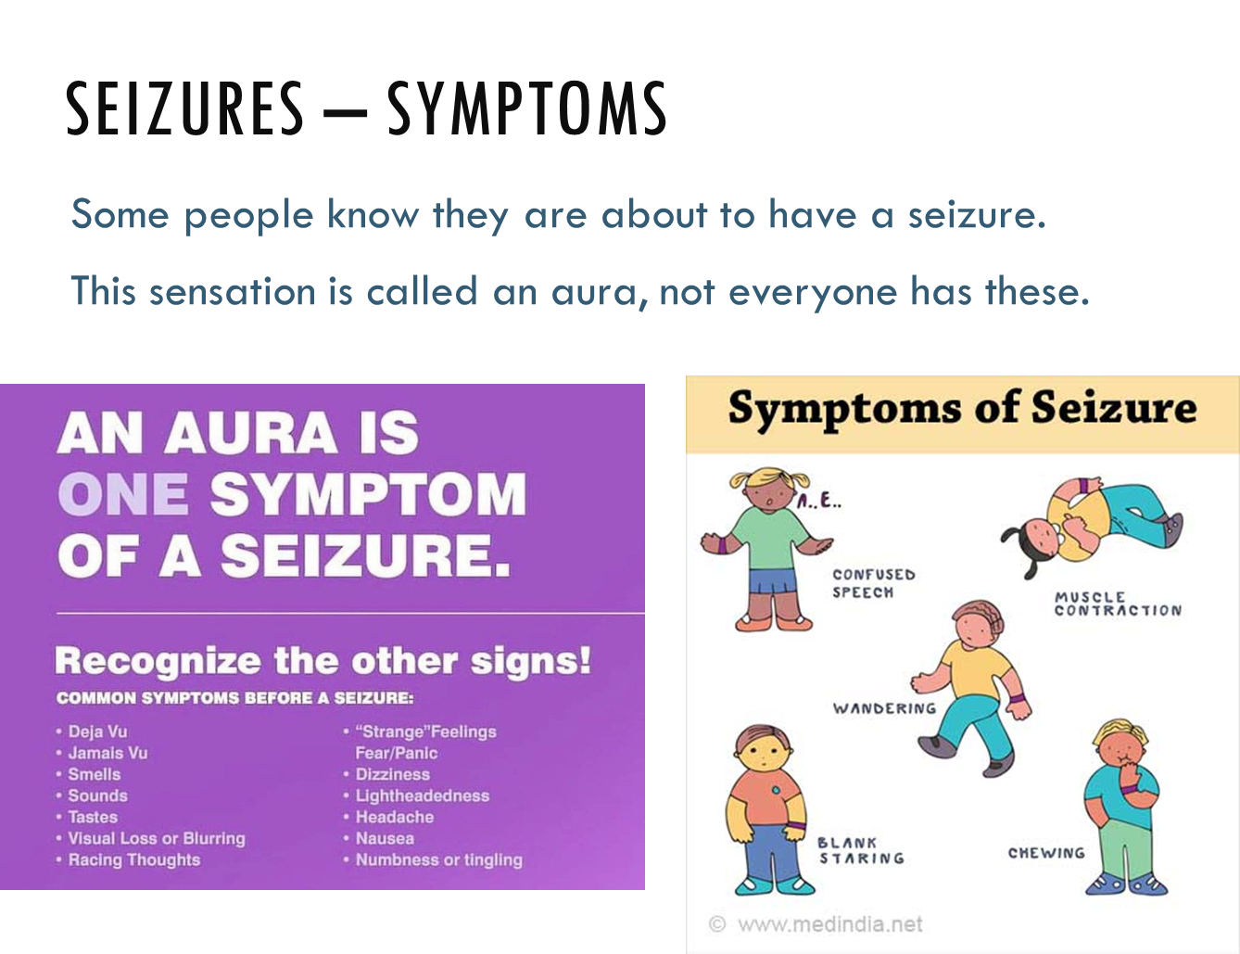

Slide 33
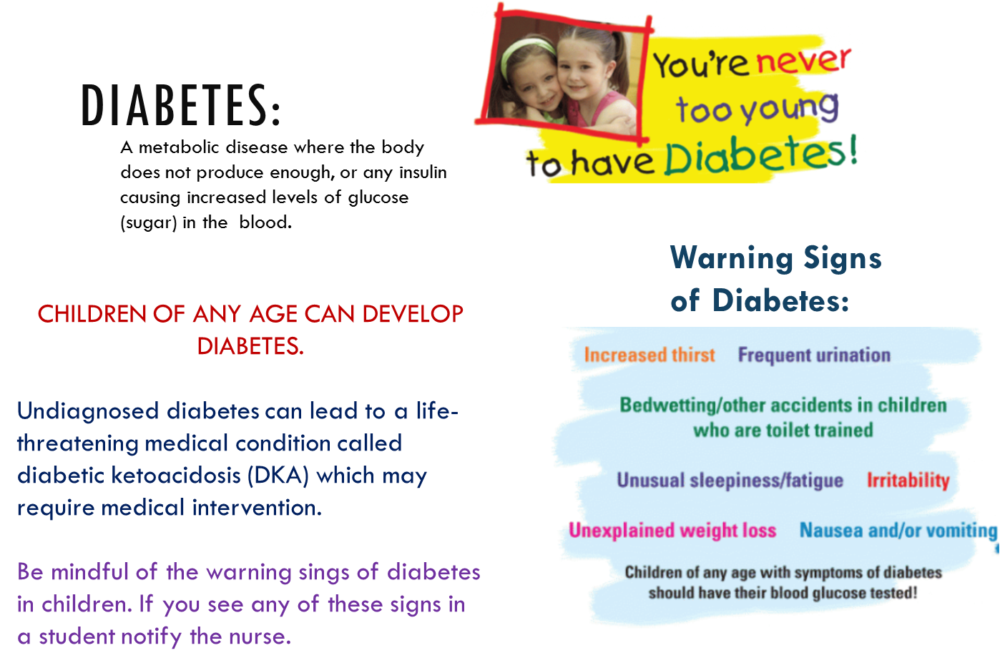
Notes:
The number of diabetic students in Beaufort County Schools continues to rise.
Being aware of the warning signs can help save a student’s life.

Slide 34
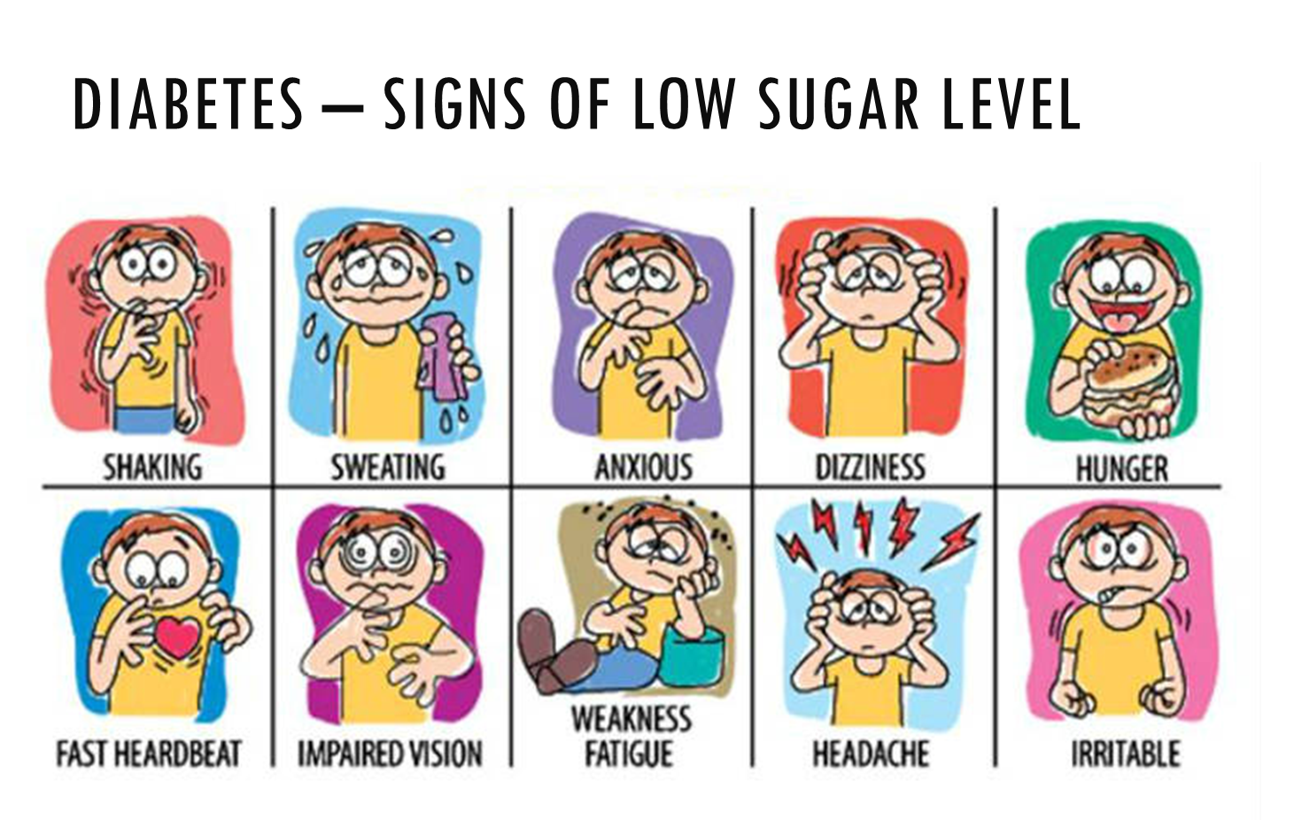
Notes:
During the day students blood sugar levels fluctuate. A low blood sugar is the most dangerous situation for a diabetic. Knowing the signs and symptoms of low blood sugar can help save a life.

Slide 35
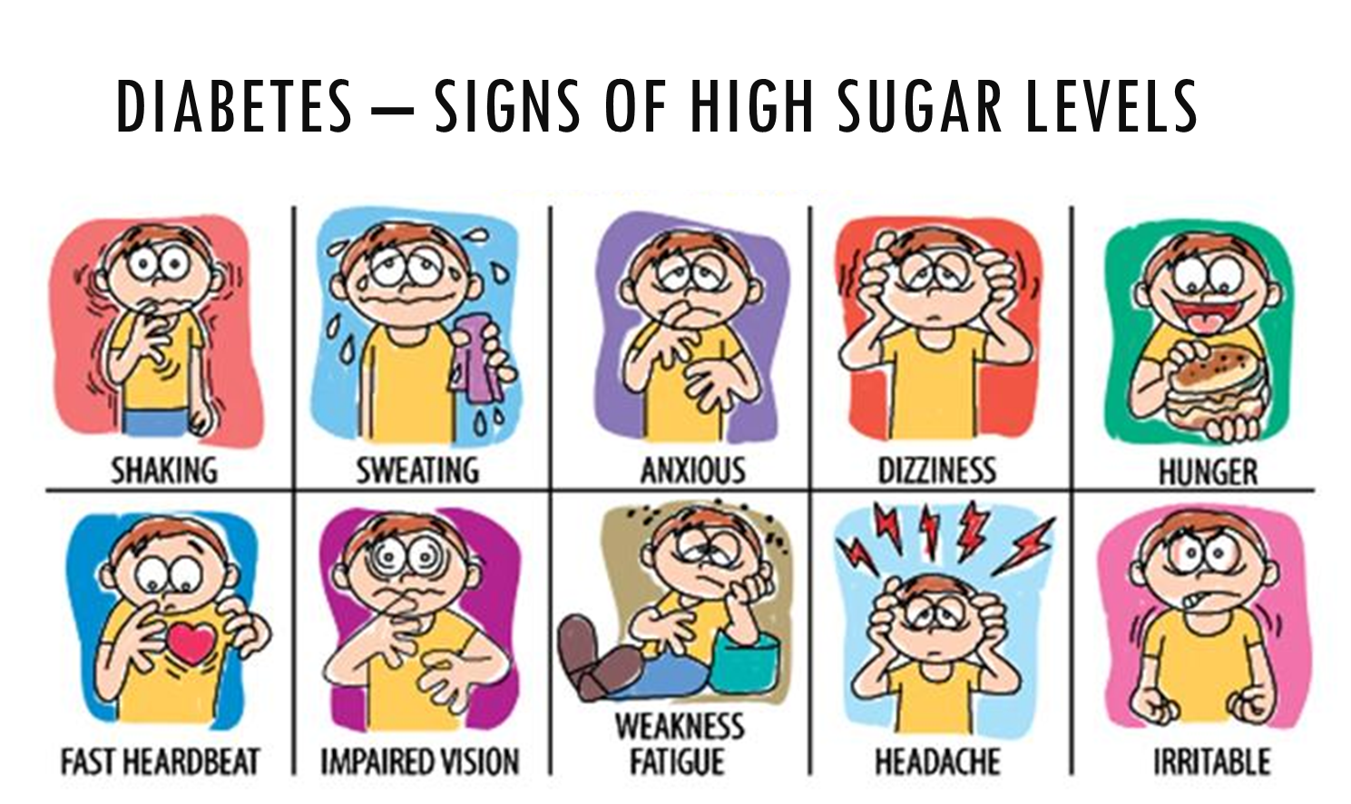
Notes:
Many symptoms of high blood sugar are similar to low blood sugar. It is important to have a student check blood sugar levels.

Slide 36
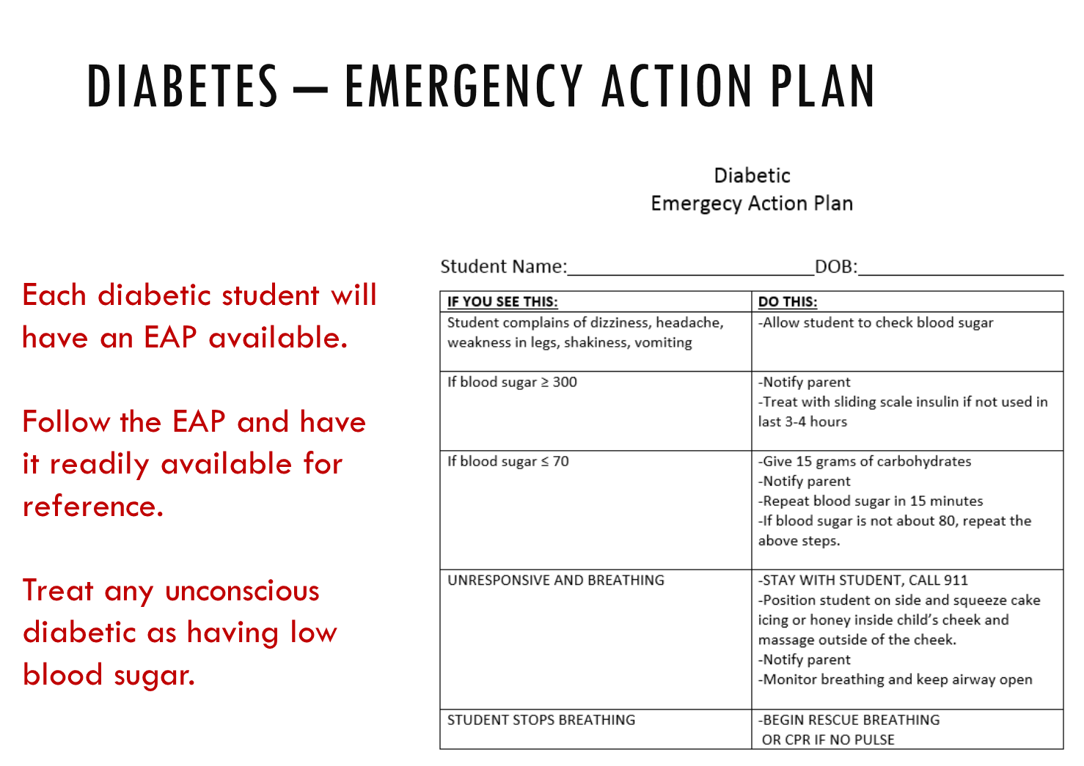
Notes:
An emergency action plan is available for each diabetic student.
If a diabetic student should become unconscious treat them as having low blood sugar and follow the action plan.
This will not harm a student if the blood sugar is high.

Slide 37
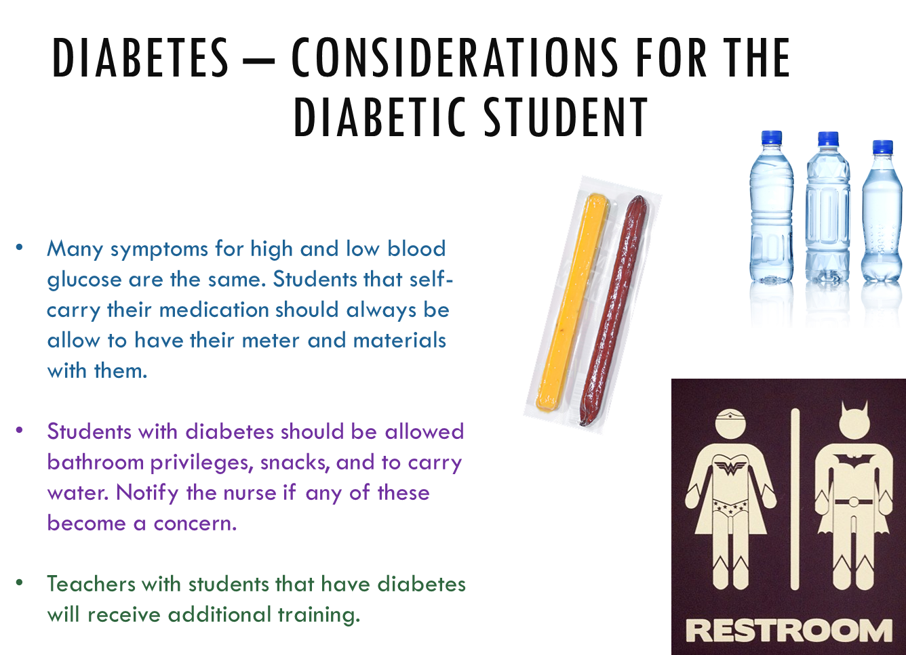
Notes:
It is important that these students are allowed unlimited bathroom breaks. They also should be permitted to carry water and snacks with them at all times.
Many keep their equipment with them and may check their blood sugars or give themselves insulin throughout the day.

Slide 38
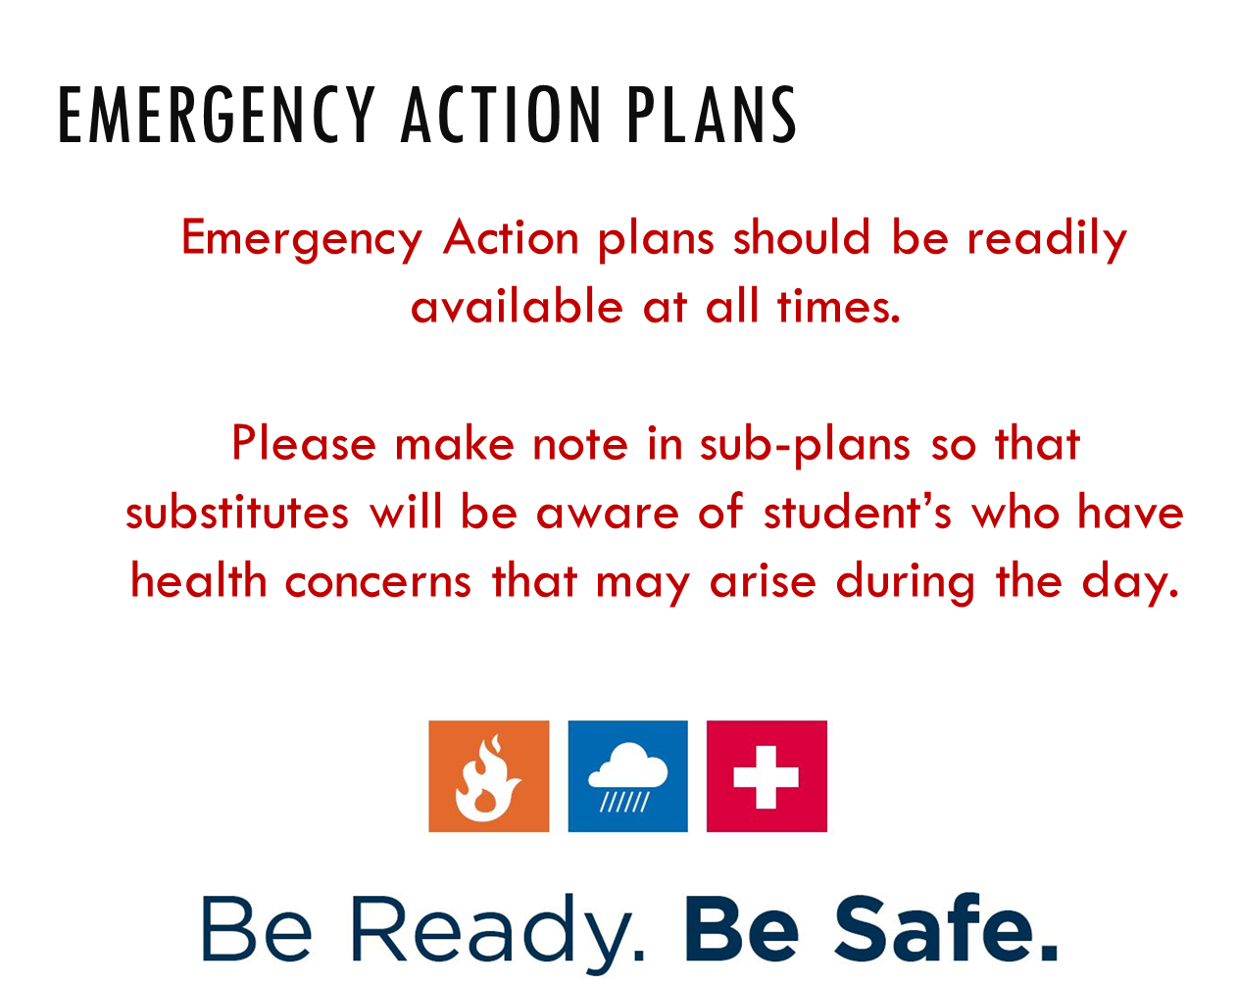
Notes:
Emergency Action plans should be readily available at all times.
Please make note in sub-plans so that substitutes will be aware of student’s who have health concerns that may arise during the day.

Slide 39
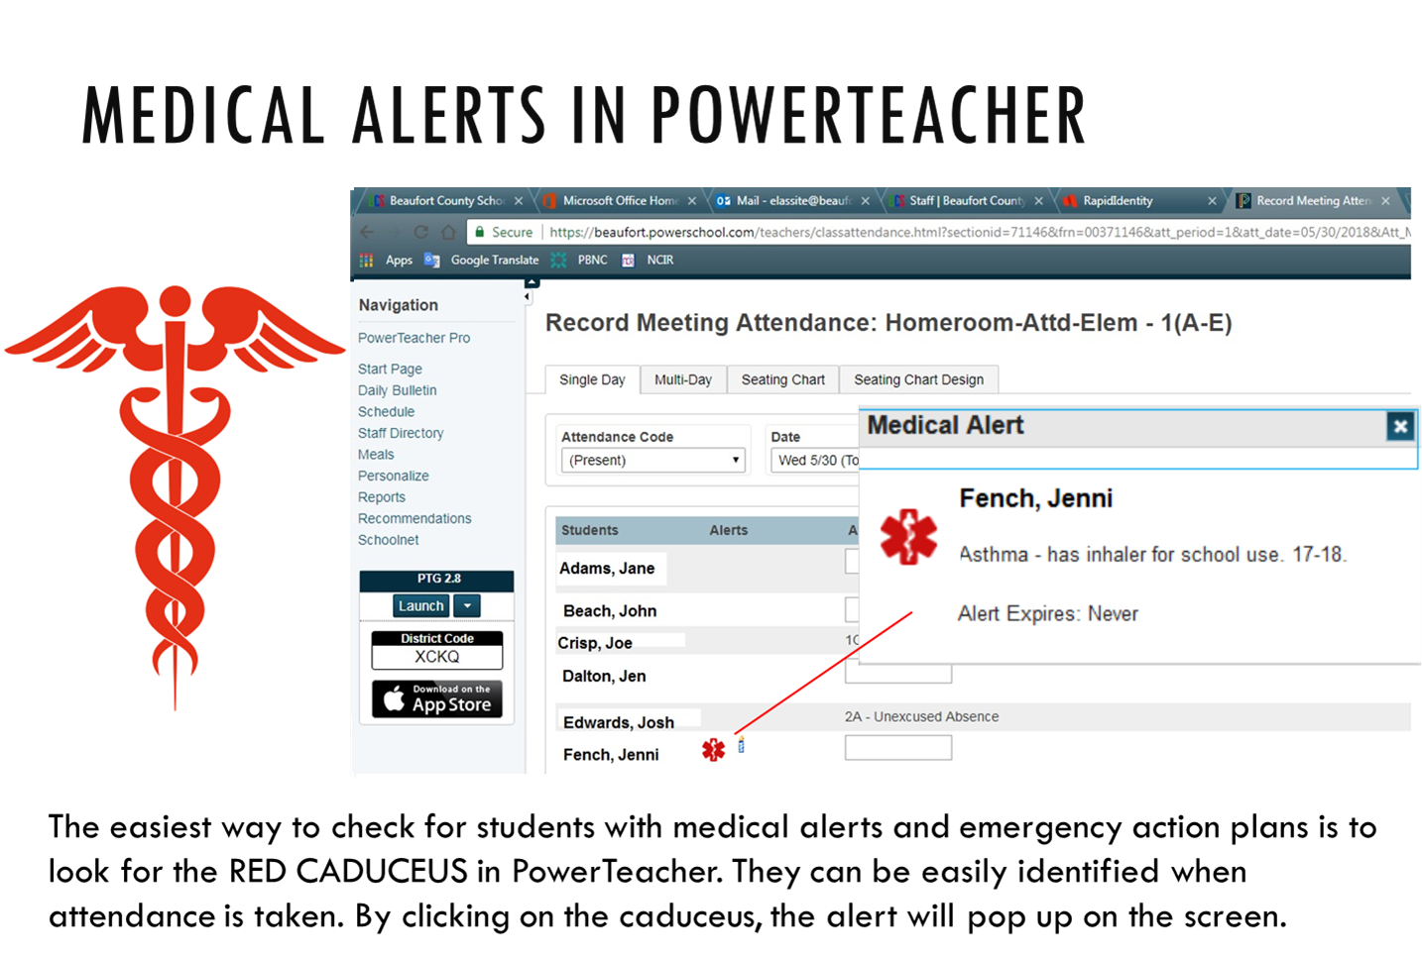

Slide 40
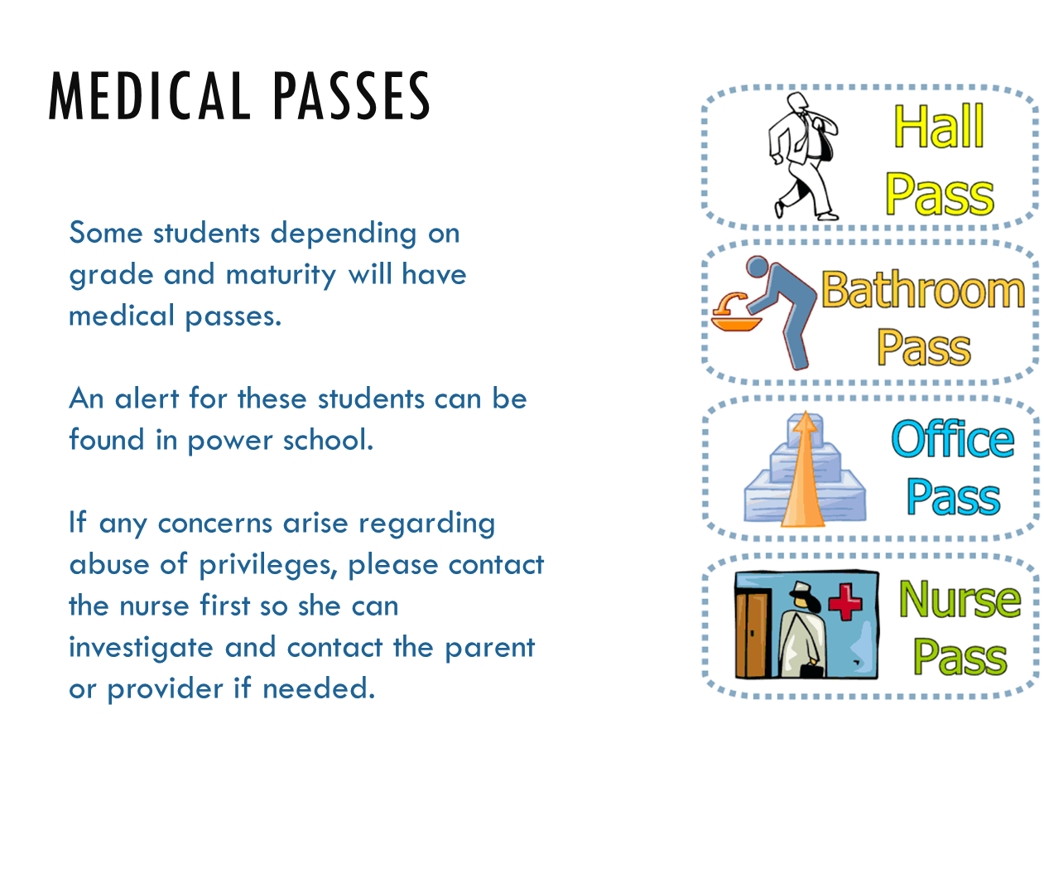

Slide 41
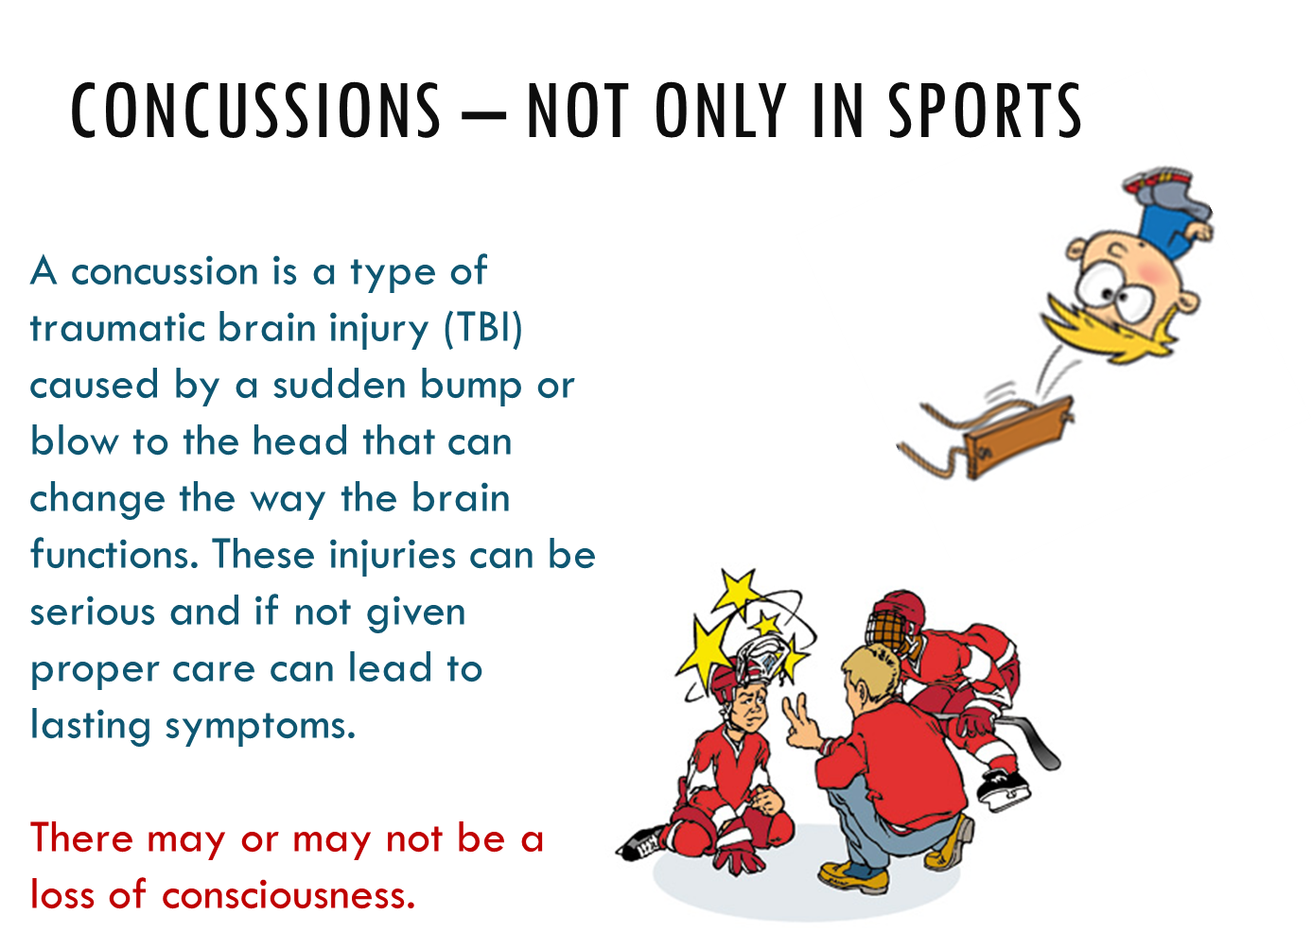
Notes:
A concussion is a type of traumatic brain injury (TBI) caused by a sudden bump or blow to the head that can change the way the brain functions. These injuries can be serious and if not given proper care can lead to lasting symptoms.

Slide 42
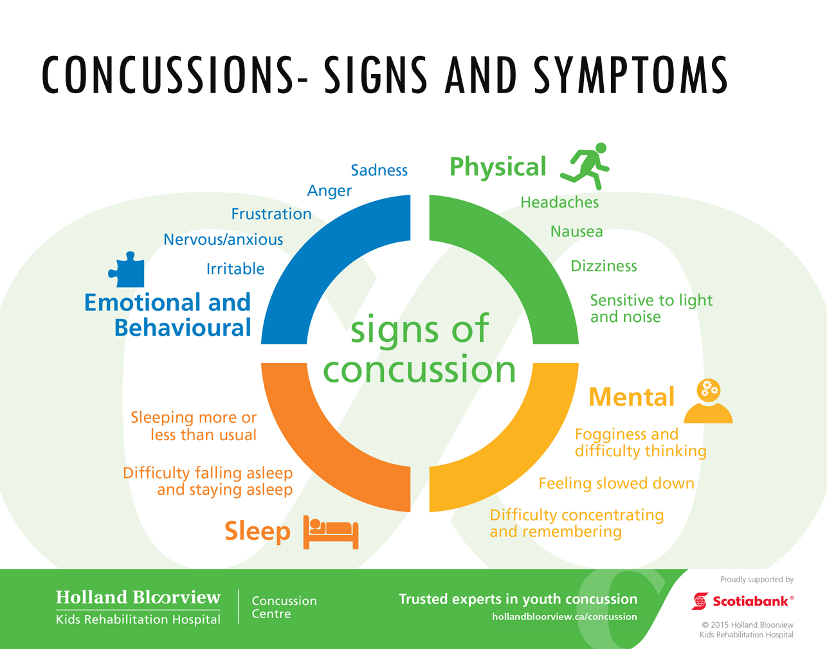
Notes:
Symptoms of a concussion can affect many functions of the brain.
Students many report one of many symptoms depending of the severity of the injury.
Loss of consciousness is not required for a diagnosis of concussion.

Slide 43

Notes:
Early recognition and treatment of a concussion will result in the best outcome.
Brain rest is the most important treatment. This includes: no video games, TV, texting, reading or other activities that require concentration.
Beaufort County Schools have a return to learn and a return to play policy. Athletes require clearance by a medical doctor before returning to play.

Slide 44
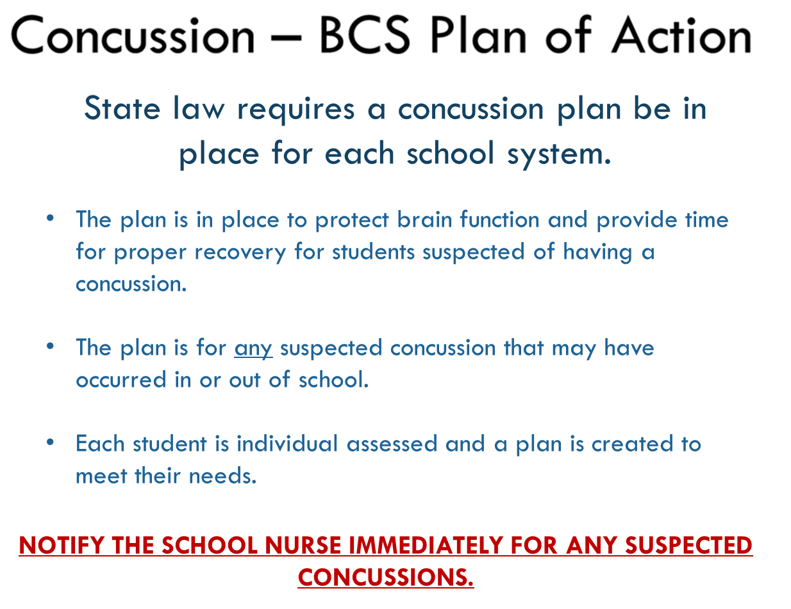
Notes:
As required by state law, a “Return-to-Learn” concussion plan has been developed and is being implemented for the 2016-2017 school year. It is important to note that our student athletes will continue to follow the athletic concussion protocol. A concussion contact, designated by the principal, will be in place at each school. This person should be notified immediately when a concussion is suspected.

Slide 45
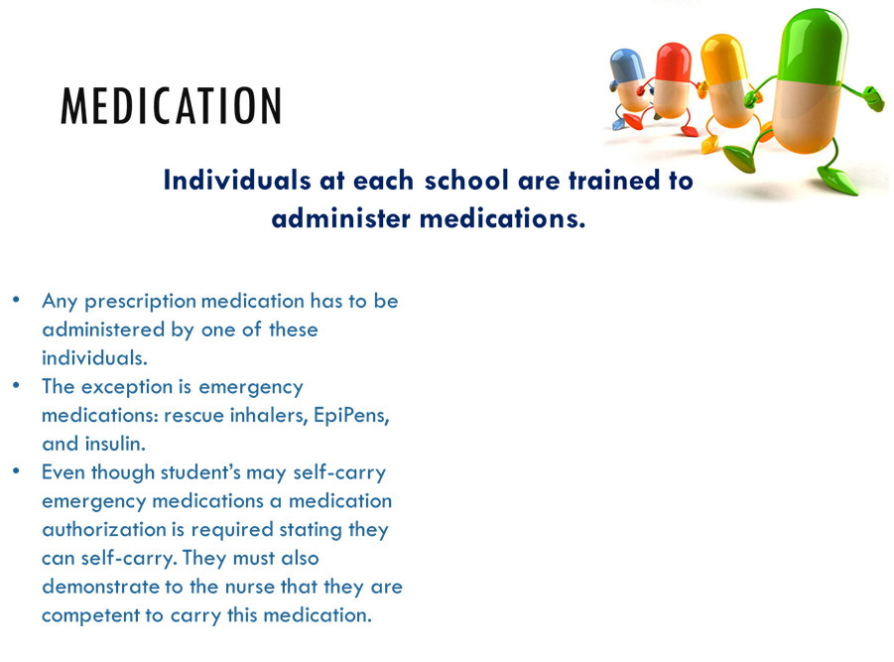
ALL STUDENTS
MUST HAVE A
MEDICATION AUTHORIZATION ON FILE FOR
ANY MEDICATION.
THIS INCLUDES OVER THE COUNTER MEDICATIONS FOR STUDENTS IN GRADES 6-12.
Notes:
Each principal designates individuals to administer medication. These individuals are trained to administer medication.
A prescription medication requires an annual medication authorization signed by the health care provider. Students with emergency medication may be assessed by the school nurse and allowed to self-carry.
Only students in 6th – 12th grade are allowed to carry over the counter medications in the original container without an authorization.

Slide 46
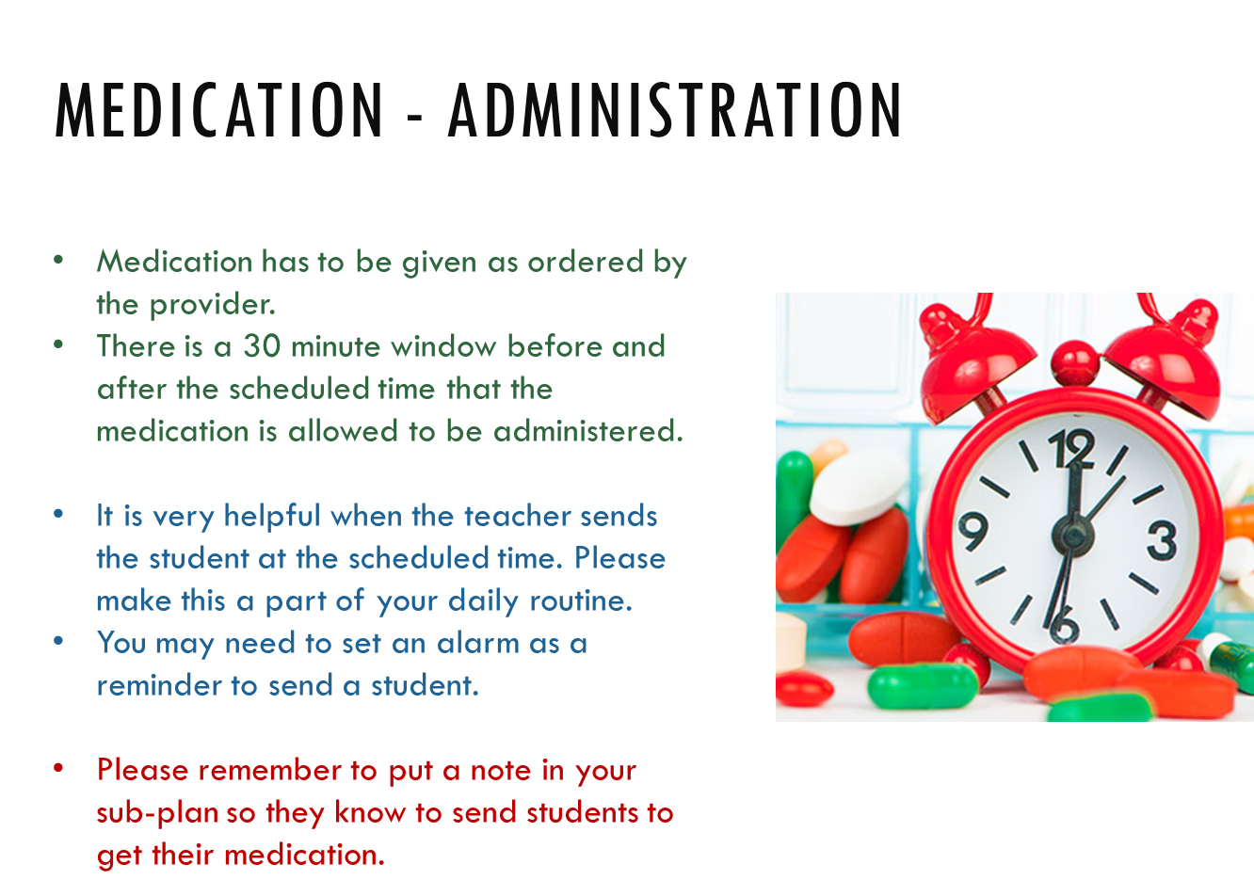
Notes:
Medication must be given within 30 minutes of the time ordered by the provider.
Teachers should make every effort to incorporate into their daily routine sending students for medication at scheduled times. This helps everyone involved.
Please make note in your sub-plans for students who need to be sent for medication.

Slide 47
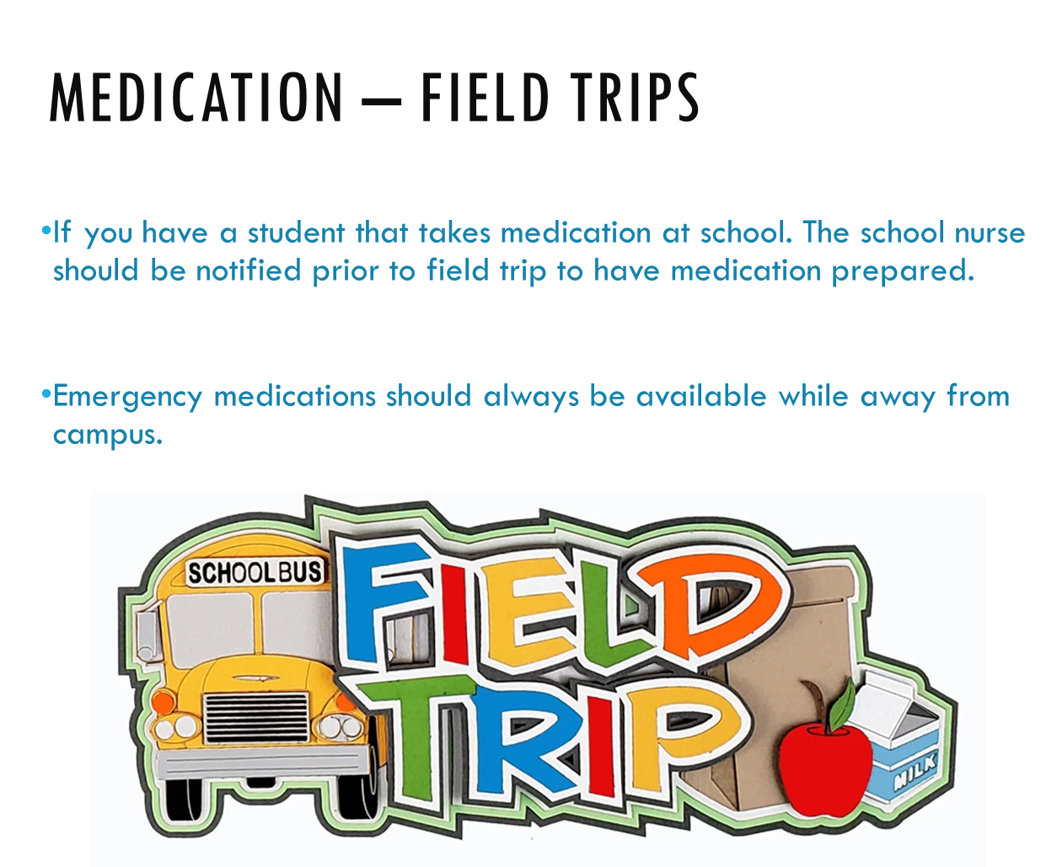

Slide 48

Notes:
When a trip is overnight and medication needs to be given authorizations need to be completed as if the medication was being given at school.
Some students take medication before and after school. This needs to be considered when you are first made aware of the trip and the school nurse should be notified at least one month prior to departure.

Slide 49
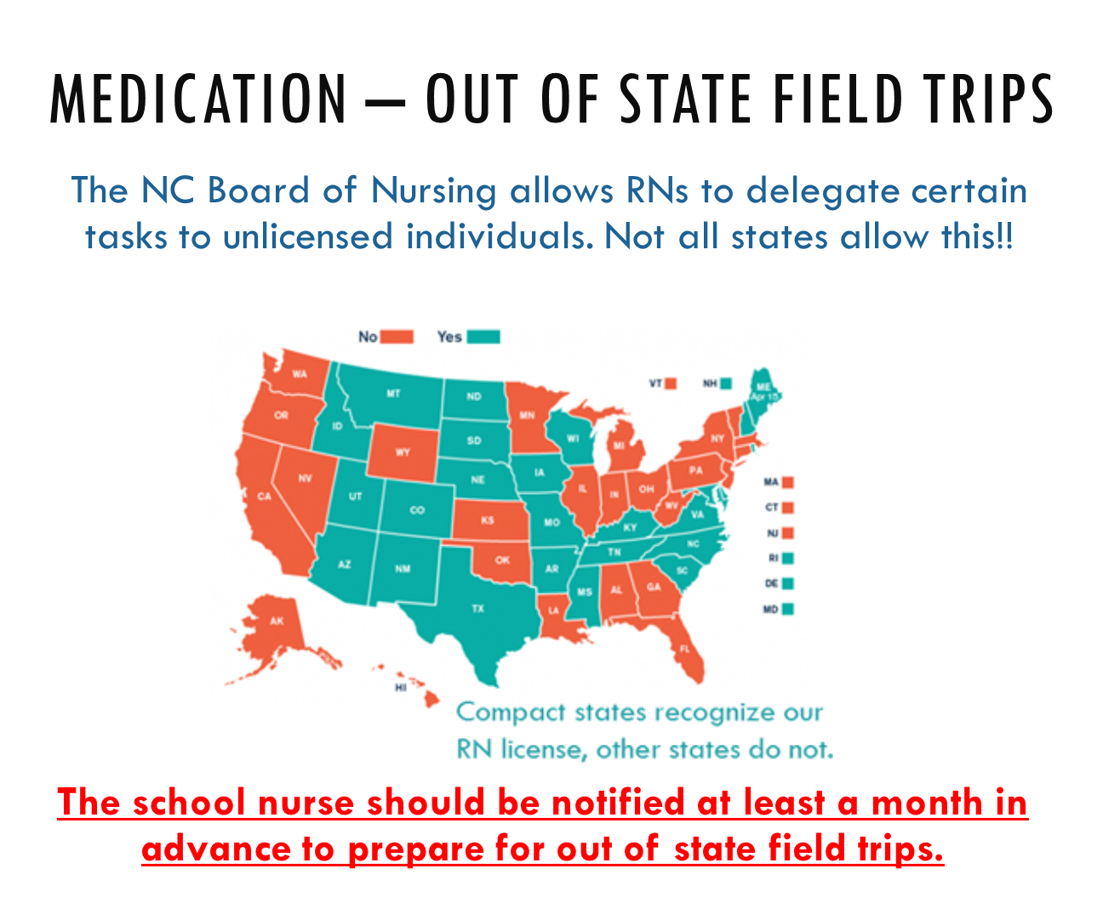
Notes:
Your school nurse MUST be notified in advance of any out-of-state field trips as soon as they are planned. A medication letter will be required to go home with the permission slips.

Slide 50
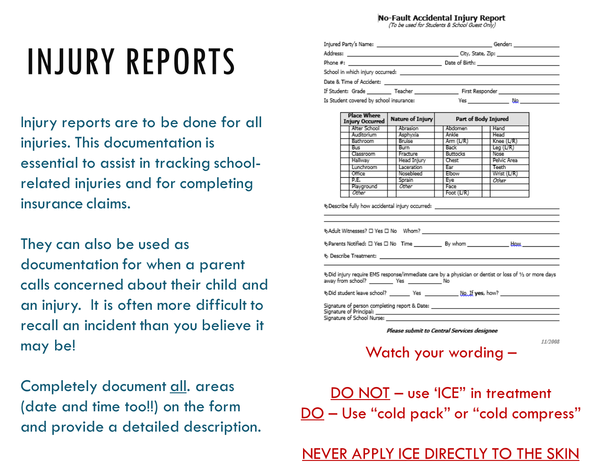
Notes:
Injury reports are to be done for all injuries. Completely document all areas (date and time too!!) on the form and provide a detailed description. Watch your wording – DO NOT – use ‘ICE” in treatment; DO – Use “cold pack” or “cold compress”

Slide 51


Slide 52

Notes:
Head lice do not carry disease; do not panic! They do not jump, fly or swim. Poor hygiene does not attract lice.

Slide 53
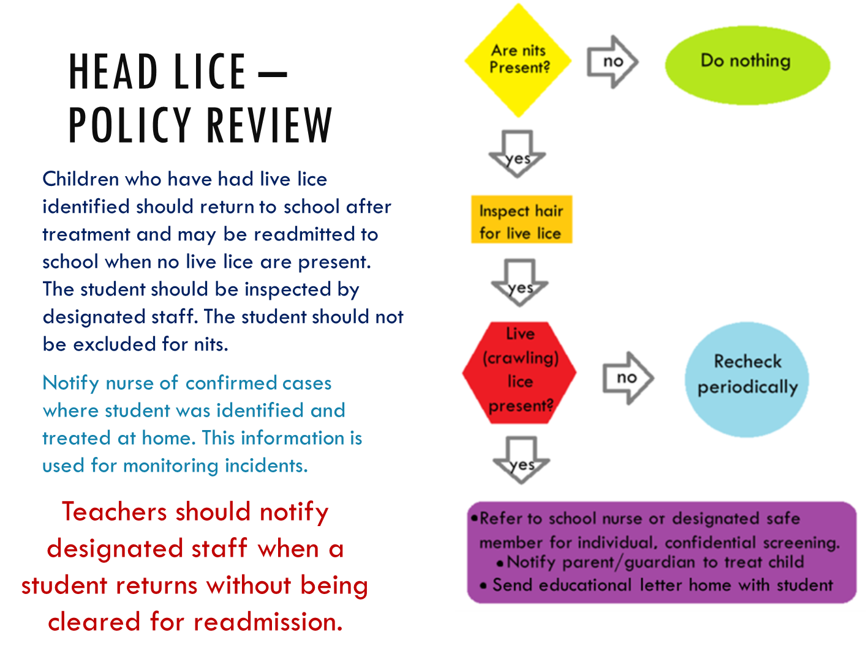
Notes:
Children who have had live lice identified should return to school after treatment and may be readmitted to school when no live lice are present. The student should be inspected by designated staff in a private setting. The student should not be excluded for nits.
Notify nurse of confirmed cases where student was identified and treated at home.

Slide 54
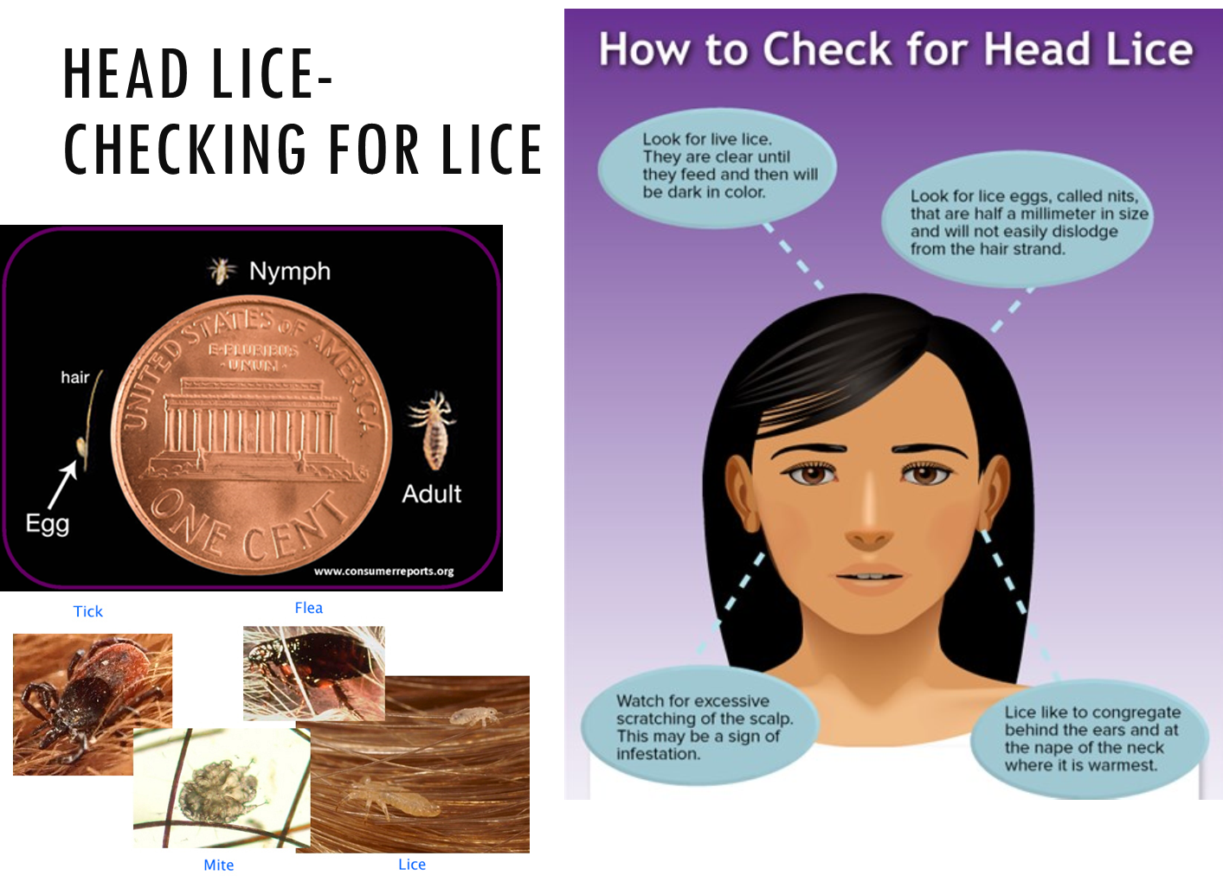
Notes:
Checking for head lice includes inspecting the scalp around ears and the nape of the neck for live lice. They are clear until they feed and then they are dark. Also inspect the hair shafts for eggs (called nits); these can look like dandruff, but are not as easily removed.

Slide 55
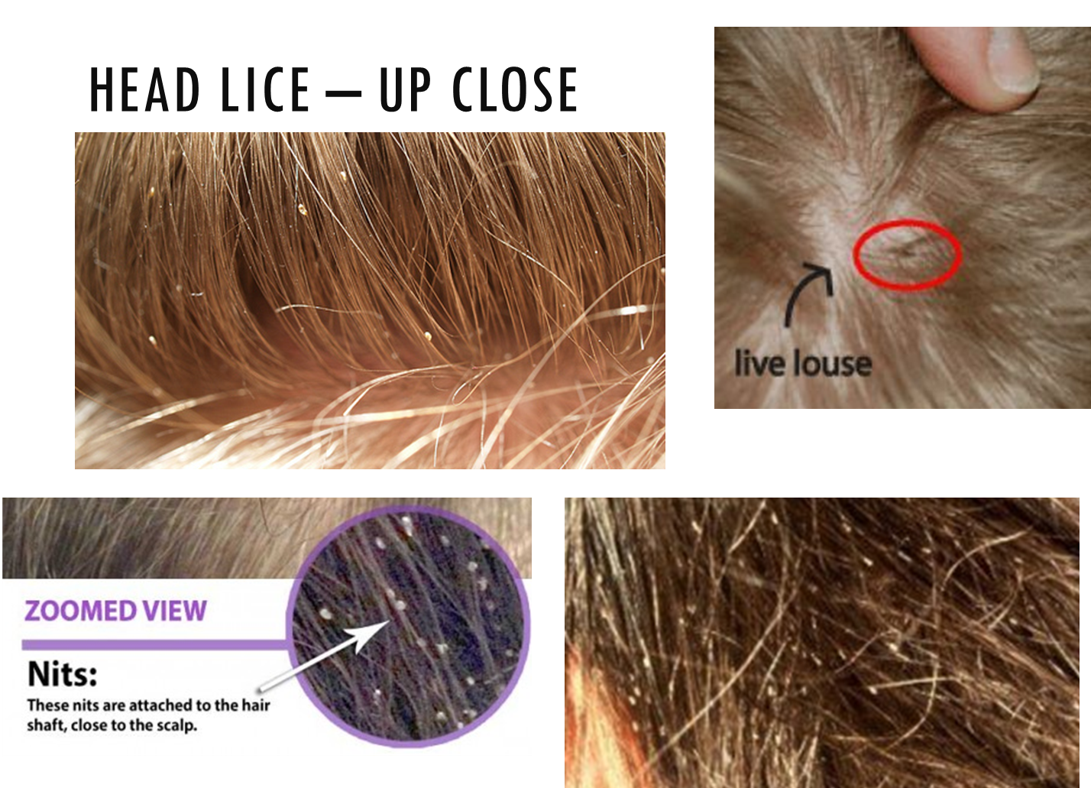
Notes:
Freshly laid nits are attached to the hair shaft close to the scalp, where it is warm.

Slide 56
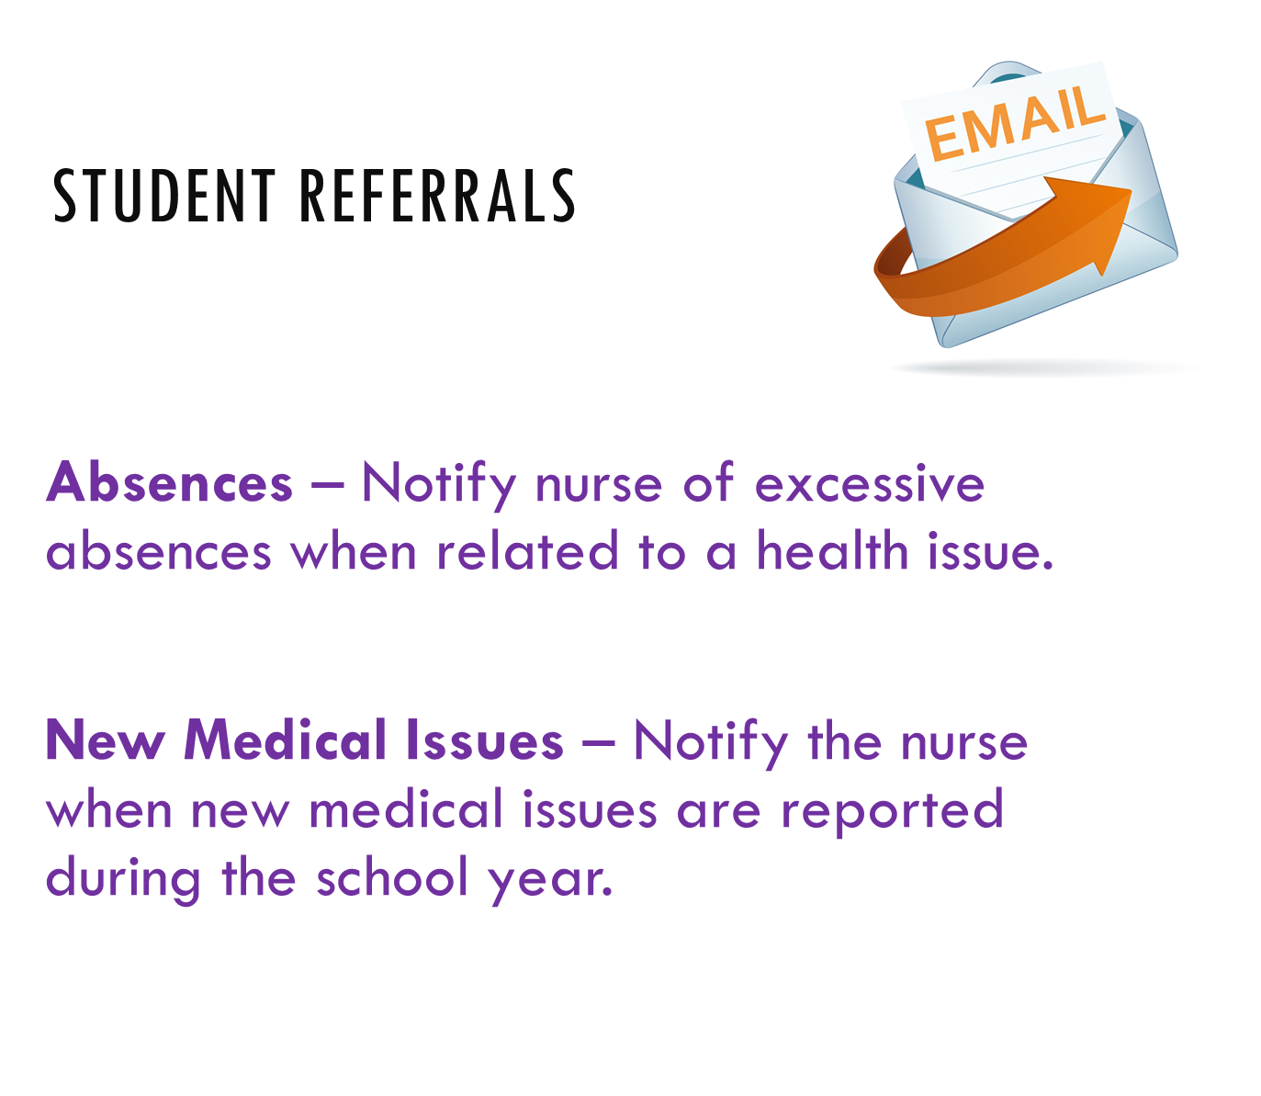
Notes:
Notify nurse of excessive absences when related to a health issue.
Notify the nurse when new medical issues are reported during the school year.
If a parent notifies you, request they also notify the school nurse.

Slide 57
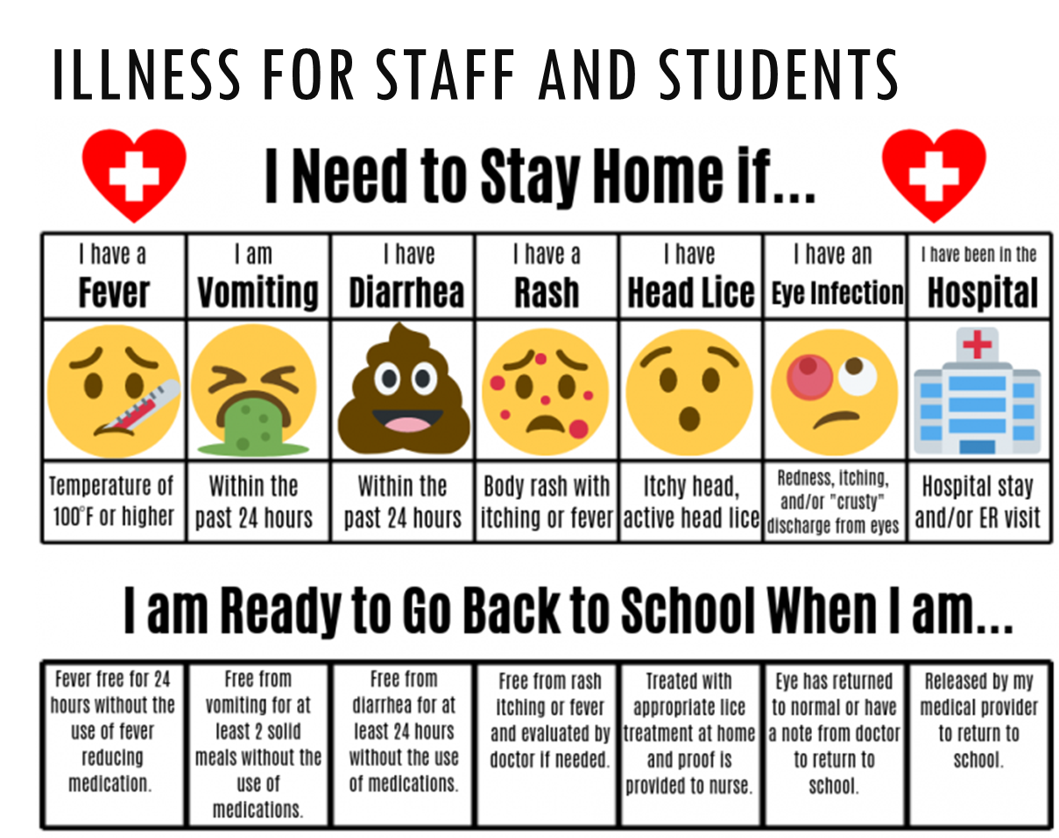

Slide 58
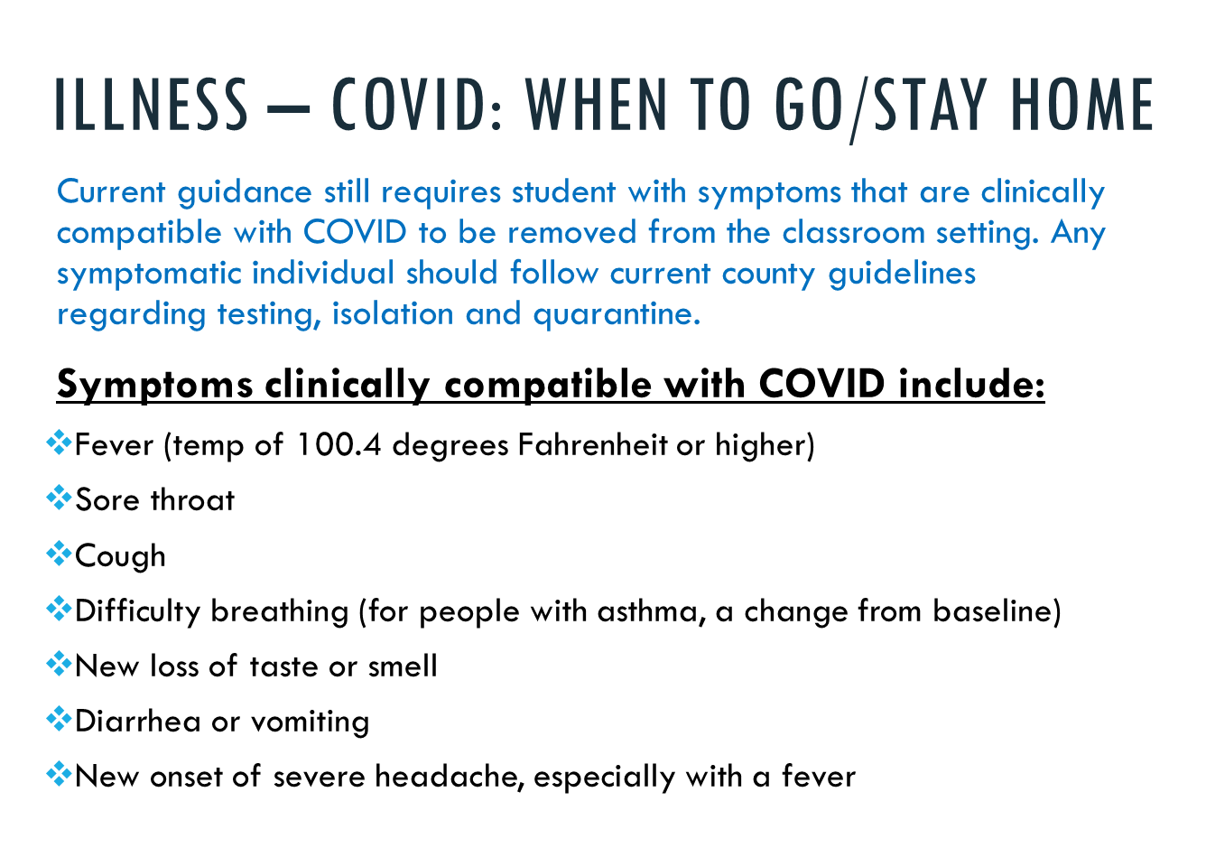

Slide 59
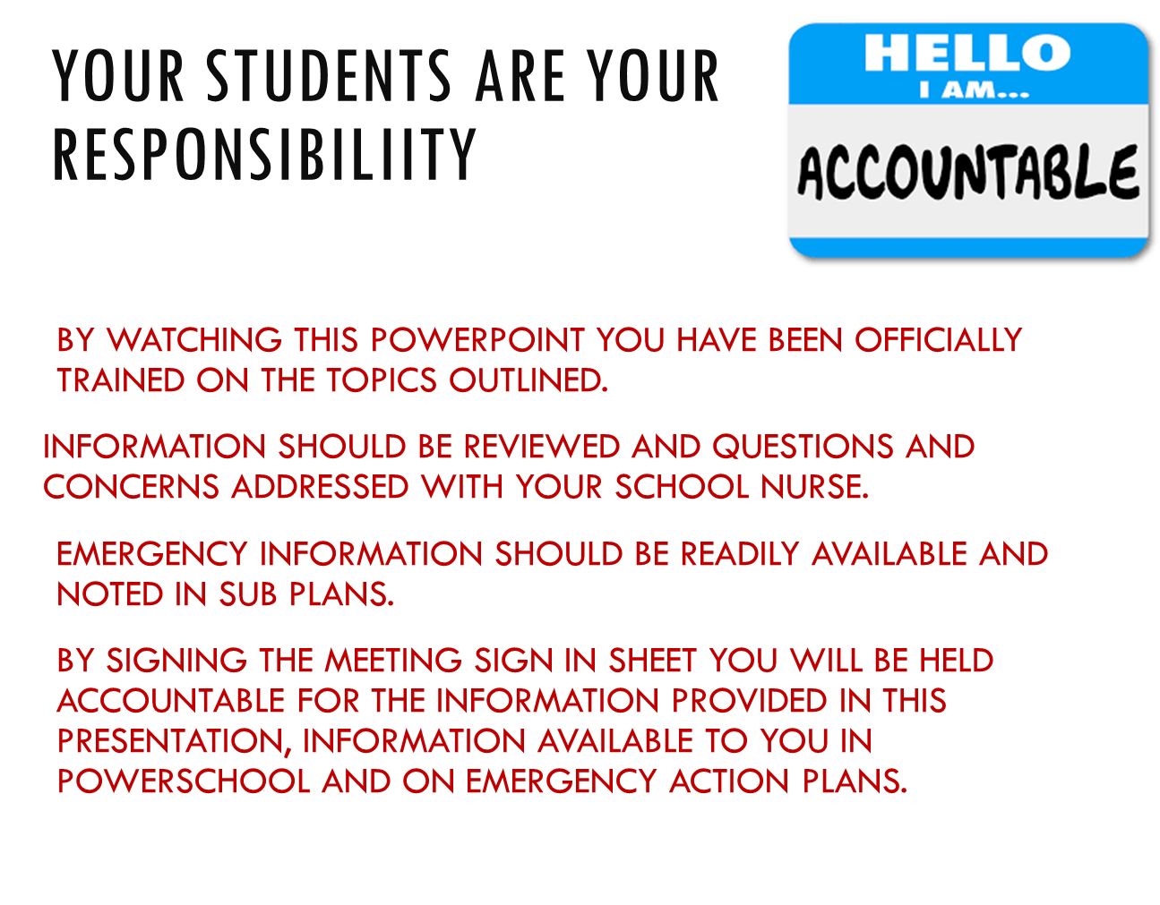

Slide 60

Notes:
If you have any additional questions, concerns or if issues arise during the school year, don’t hesitate to contact your school nurse! Remember we are available to the faculty and staff as well. That is what we are here for…..your school health authority.

